Slide 1



Slide 2

Wage and Employment Dynamics Project
Research Ready Datasets
Research With Impact
Stakeholder Engagement
Capacity Building

Slide 3
A vision… data spine
1. This data exists
gender
ethnicity
nationality
age
education
occupation
etc …
wages
hours
industry
location
bonuses
occupation
etc …
income
support
pensions
child support
disability
housing
etc …
gender
ethnicity
nationality
age
education
occupation
etc …
wages
hours
industry
location
bonuses
occupation
etc …
income
support
pensions
child support
disability
housing
etc …
gender
ethnicity
nationality
age
education
occupation
etc …
wages
hours
industry
location
bonuses
occupation
etc …
income
support
pensions
child support
disability
housing
etc …
2. Not in one place
gender
ethnicity
nationality
age
education
occupation
etc …
wages
hours
industry
location
bonuses
occupation
etc …
income
support
pensions
child support
disability
housing
etc …
gender
ethnicity
nationality
age
education
occupation
etc …
wages
hours
industry
location
bonuses
occupation
etc …
income
support
pensions
child support
disability
housing
etc …
gender
ethnicity
nationality
age
education
occupation
etc …
wages
hours
industry
location
bonuses
occupation
etc …
income
support
pensions
child support
disability
housing
etc …
gender
ethnicity
nationality
age
education
occupation
etc …
wages
hours
industry
location
bonuses
occupation
etc …
income
support
pensions
child support
disability
housing
etc …
gender
ethnicity
nationality
age
education
occupation
etc …
wages
hours
industry
location
bonuses
occupation
etc …
income
support
pensions
child support
disability
housing
etc …
work history

Slide 4
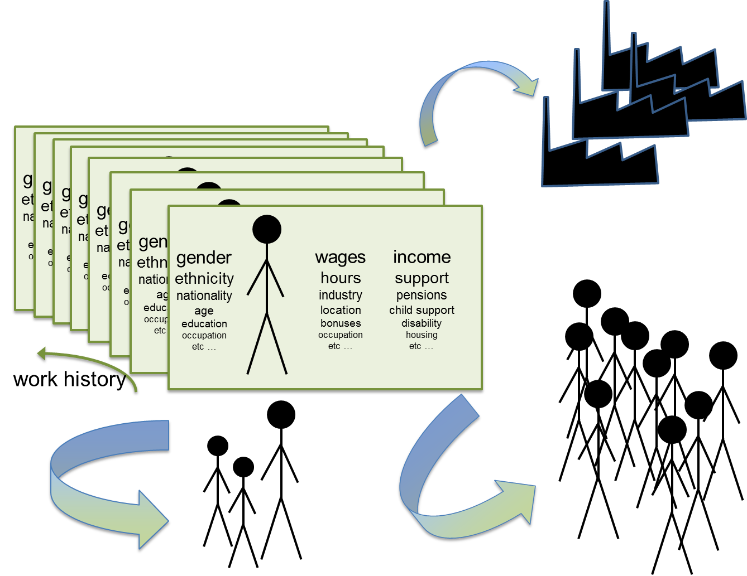
ONS ASHE data
1. This data exists
ONS business data
DWP data
2. Not in one place
HMRC data
HESA/DfE data
Census

Slide 5
WED Model
Research-ready data
Research With Impact
ONS business register
Review
QA
Link
Document
Add common personal IDs
Wage and Employment Spine
wage progression
low-wage labour markets
(Enhanced) ASHE
2011 Census
HMRC data:
1. PAYE
2. Self Assessment
3. Migrant Workers Scan

Slide 6
Research Ready Data – WED Data Spine
Annual Survey of Hours and Earnings (ASHE)
  Important source of official statistics on earnings and working hours in the UK labour market
  Used by LPC to monitor the impact of NMW/NLW
  Used by DWP to analyse pension changes
  1% sample of employee jobs, taken randomly from the PAYE register
  Survey completed by their employer if working in April each year

Slide 7
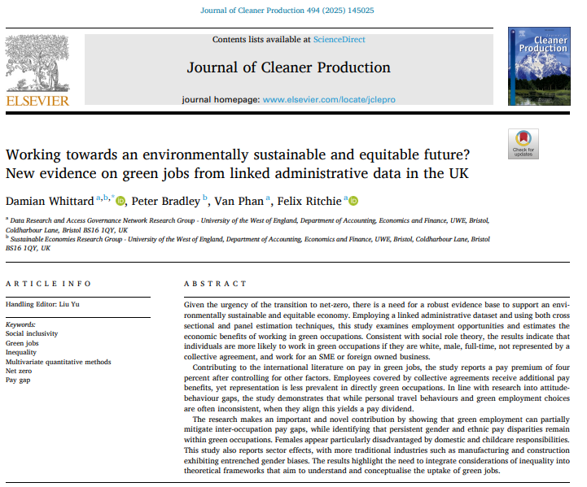
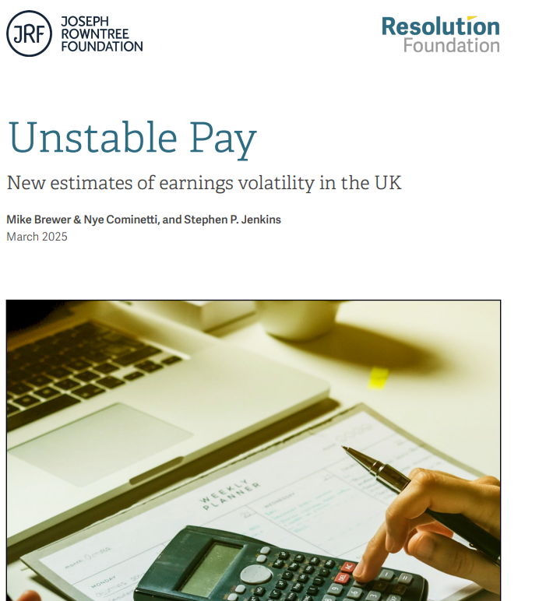
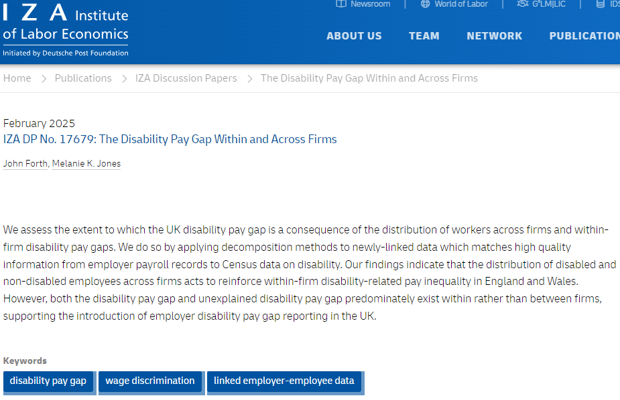
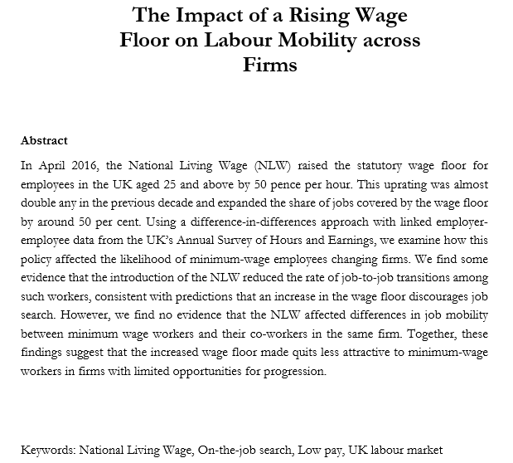
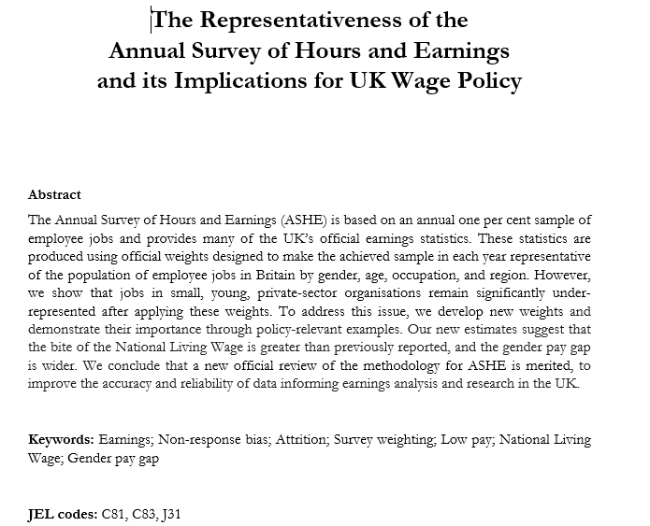

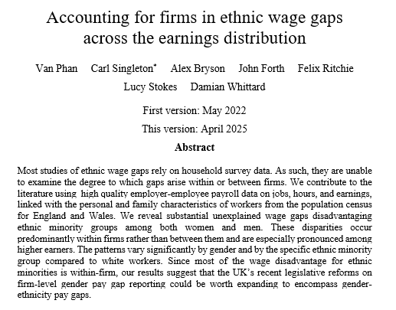
Research with Impact

Slide 8
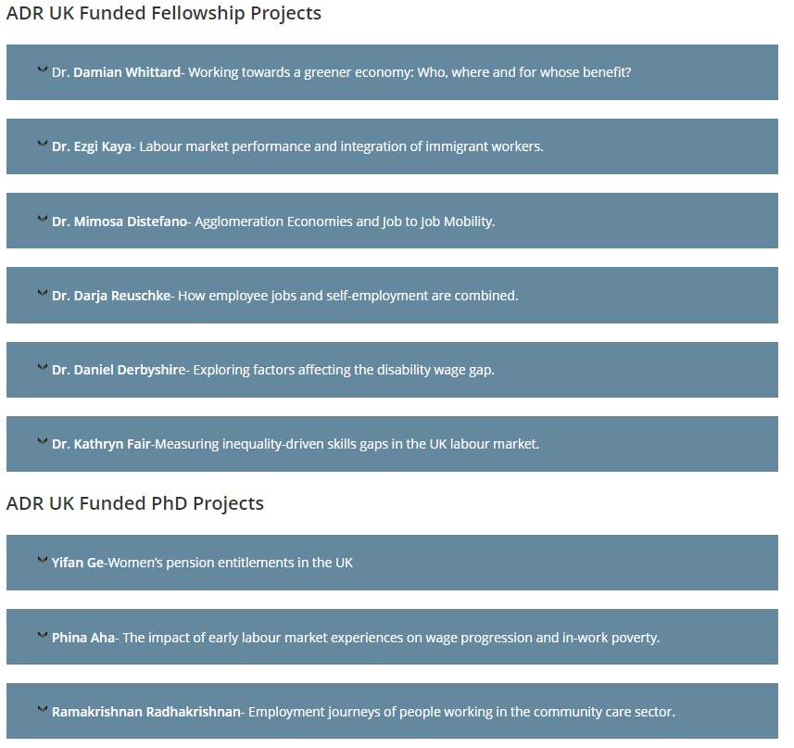
Research with Impact

Slide 9









Impact and Engagement: Three Stakeholder Groups

Slide 10

Impact and Engagement
Work with strategic partners
  Office for National Statistics
  Low Pay Commission
  Resolution Foundation
20+ working papers, policy briefs, and data insights
10+ policy and research workshops
Public engagement
  E.g. Pint of Science
10+ training events (webinars, face-to-face sessions)
Peer to peer networks

Slide 11
Stakeholder Engagement: Supporting the Community
WED Website
  https://www.wagedynamics.com
Community of Interest group
  https://www.wagedynamics.com/community-of-interests/
Knowledge Hub
  https://khub.net/group/wage-and-employment-dynamics-research-group/

Slide 12
Impact: Lessons Learned
Need to factor in considerable time and resources for engagement and impact
Bringing stakeholders in at the outset strengthens policy relevance
Impact is cumulative, not one-off
Co-production with policy bodies increases ownership
Timeliness is critical for policy influence
Translating technical findings into accessible formats is essential
Embedding advisory boards strengthens credibility
Visibility in high-profile forums boosts uptake
Peer-to-peer learning accelerates skills transfer
Training programmes extend impact beyond the project team
Fellowship and PhD support encourages the next generation of researchers
Evidence of tangible change strengthens the case for continued funding
A self-sustaining community of interest is the best way to ensure longevity

Slide 13
Thank You
Any questions?
Damian2.Whittard@uwe.ac.uk

