Slide 1

RES special session 8
New developments in labour markets data

Slide 2
Plan for today
Rebecca Riley KCL & ESCoE | Chair’s introduction
Van Phan & Felix Ritchie UWE Bristol | Introduction to WED Illustrative results from PAYE/MWS
Rosie French ADRUK | The ADRUK perspective
Christina Palmou OECD, KCL & ESCoE | Review and future developments
Felix Ritchie UWE Bristol | Wrap up & questions for audience
Discussion and audience questions

Slide 3


Van Phan, Felix Ritchie, Damian Whittard – UWE
Alex Bryson – UCL
John Forth – City, London
Carl Singleton, Rachel Scarfe – Stirling
Notes:
We’re excited to present insights from our work using newly-linked ASHE - HMRC datasets to better understand the dynamics of income and employment in the UK. Let’s dive in.

Slide 4
What is the WED project?

Slide 5
A vision… data spine
1. This data exists
gender
ethnicity
nationality
age
education
occupation
etc …
wages
hours
industry
location
bonuses
occupation
etc …
income
support
pensions
child support
disability
housing
etc …
gender
ethnicity
nationality
age
education
occupation
etc …
wages
hours
industry
location
bonuses
occupation
etc …
income
support
pensions
child support
disability
housing
etc …
gender
ethnicity
nationality
age
education
occupation
etc …
wages
hours
industry
location
bonuses
occupation
etc …
income
support
pensions
child support
disability
housing
etc …
2. Not in one place
gender
ethnicity
nationality
age
education
occupation
etc …
wages
hours
industry
location
bonuses
occupation
etc …
income
support
pensions
child support
disability
housing
etc …
gender
ethnicity
nationality
age
education
occupation
etc …
wages
hours
industry
location
bonuses
occupation
etc …
income
support
pensions
child support
disability
housing
etc …
gender
ethnicity
nationality
age
education
occupation
etc …
wages
hours
industry
location
bonuses
occupation
etc …
income
support
pensions
child support
disability
housing
etc …
gender
ethnicity
nationality
age
education
occupation
etc …
wages
hours
industry
location
bonuses
occupation
etc …
income
support
pensions
child support
disability
housing
etc …
gender
ethnicity
nationality
age
education
occupation
etc …
wages
hours
industry
location
bonuses
occupation
etc …
income
support
pensions
child support
disability
housing
etc …
work history

Slide 6
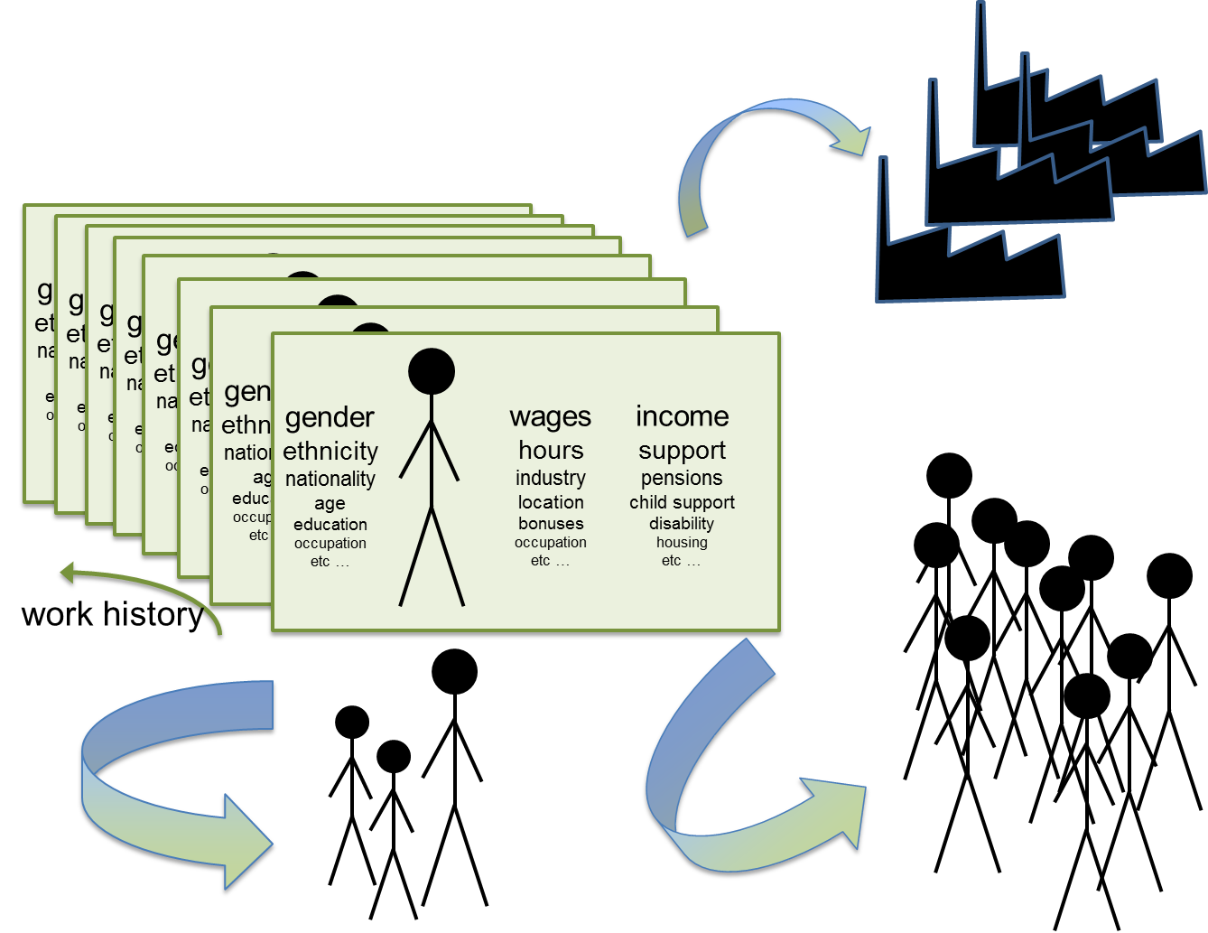
ONS ASHE data
1. This data exists
ONS business data
DWP data
2. Not in one place
HMRC data
HESA/DfE data
Census

Slide 7
WED Project: funding model
Research-ready data
Research With Impact
ONS business register
Review
QA
Link
Document
Add common personal IDs
Wage and Employment Spine
wage progression
low-wage labour markets
(Enhanced) ASHE
2011 Census
HMRC data:
1. PAYE
2. Self Assessment
3. Migrant Workers Scan

Slide 8
ASHE data
Annual Survey of Hours and Earnings (ASHE)
  important source of official statistics on earnings and working hours in the UK labour market
  Used by LPC to monitor the impact of NMW/NLW
  Used by DWP to analyse pension changes
  1% sample of employee jobs, taken randomly from the PAYE register
  Survey completed by their employer if working in April each year
Notes:
one of the UK’s most important sources for official statistics on earnings and working hours. It plays a key role in monitoring policies, such as the impact of the National Minimum Wage (NMW) and National Living Wage (NLW), and in analyzing pension reforms.

Slide 9
WED overview
Very soon
Expected
2022
2024
2025
2026
‘Enhanced’ ASHE
ASHE - PAYE & SA
ASHE - Migrant Scan Worker
ASHE-Census 2011
ASHE-Census 2021

Slide 10
WED overview – WED team outputs
Papers:
gender/ethnicity wage gap in firms
sampling bias in ASHE
Quality measures in ASHE geography
Very soon
Expected
2022
2024
2025
2026
‘Enhanced’ ASHE
ASHE - PAYE & SA
ASHE - Migrant Scan Worker
ASHE-Census 2011
ASHE-Census 2021
Data descriptions:
Quick Guide
‘Data Explained’
‘Data Insights’

Slide 11
WED overview – other teams
Formally funded posts
3 ESRC/ADRUK PhDs
6 ESRC/ADRUK Fellowships
Very soon
Expected
2022
2024
2025
2026
‘Enhanced’ ASHE
ASHE - PAYE & SA
ASHE - Migrant Scan Worker
ASHE-Census 2011
ASHE-Census 2021
Collaborators
Resolution Foundation
Low Pay Commission

Slide 12
Early days, still – lots to do
  Only Census/core ASHE outputs so far
  Currently six ESRC PhDs, five ADRUK Fellowships using WED data
Lessons learned
  Very slow to acquire data – plan projects on delivery date
  Needs combined effort of many people

Slide 13
Illustrative research: PAYE data

Slide 14
HMRC data
HMRC data, for 1% of employees in the UK who should be represented in the ASHE sample, includes:
  Pay As You Earn (PAYE):
    Those who has employee jobs or occupational pensions
    Details of employment, and payment submission records (monthly/weekly)
    Tax year 2015-2019
  Self-assessment (SA):
    Those who made self-assessment returns
    Details of returns but missing key personal characteristics
    Covers self-employment income & employment income & other types of income
    Tax year 2011-2018
Notes:
The HMRC dataset provides another perspective, covering a broader range of incomes through:
Pay As You Earn (PAYE): Captures monthly and weekly payment records of employees and pensioners.
Self-Assessment (SA): Includes self-employment and other income details.
This data spans tax years 2011–2019 but has its limitations, such as missing personal characteristics."

Slide 15
Combining ASHE and HMRC data
HMRC PAYE
hmrc_id
HMRC SA
Lookup
ASHE
Lookup
piden
Age & Gender
Notes:
Paye_weekly_clean: pay slip records for those paid weekly (around 100k individuals)
Paye_monthly_clean: pay slip records for those paid monthly (around 300k individuals)
Paye_monthly_panel: all weekly and monthly pay slip data allocated to months
Paye_weekly_panel: all weekly and monthly pay slip data allocated to weeks
Ashe_supplement: Pay slip data by individual and year, summed across all jobs, including information on the number of jobs, proportion of time in paid employment, labour market activity at the ASHE survey date. Includes data from Employment and EoY files, some of which do not have payslips associated with them.
self-assessment returns SA (around 100k individuals)
The HMRC-PAYE data supplied to the WED project does not contain information on a person’s age and gender, but we recover these from the ASHE panel dataset, so long as a person appears there at least once in the period 1997-2022.

Slide 16
Weekly pay (ASHE vs PAYE) for people who has one job at the point in time of the ASHE survey
Notes:
Mean and median weekly wages are almost identical. ASHE data appears to have slightly more higher-paid employees but the differences are negligible.

Slide 17
#1: How many jobs, how much earned?
WED-Data-Insight-multiple-jobs-vPublish.pdf
What we did:
Using the 1% ASHE Sample Population, we count up the number of weeks in a tax year that people have at least one employee job.
We also count up the number of different jobs (employers) that people have in a year.
We can look at these employment patterns by age and gender.
Gives a rough sense of how we can now go much further than ASHE (and household surveys) to understand wage, employment, and job dynamics,
Also suggests how the data can be used to and construct complex employment histories variables for ASHE people.

Slide 18
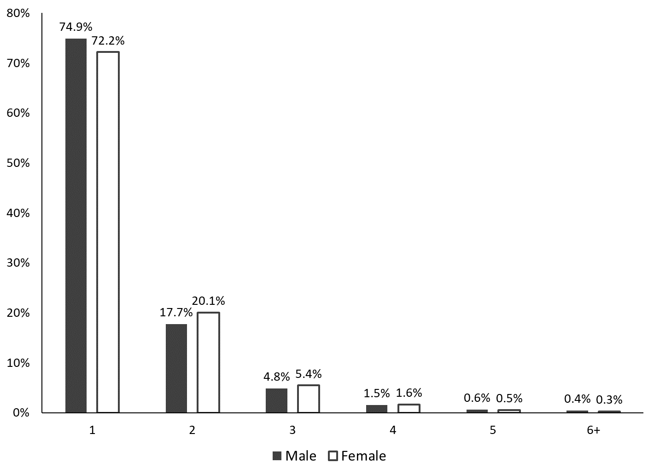
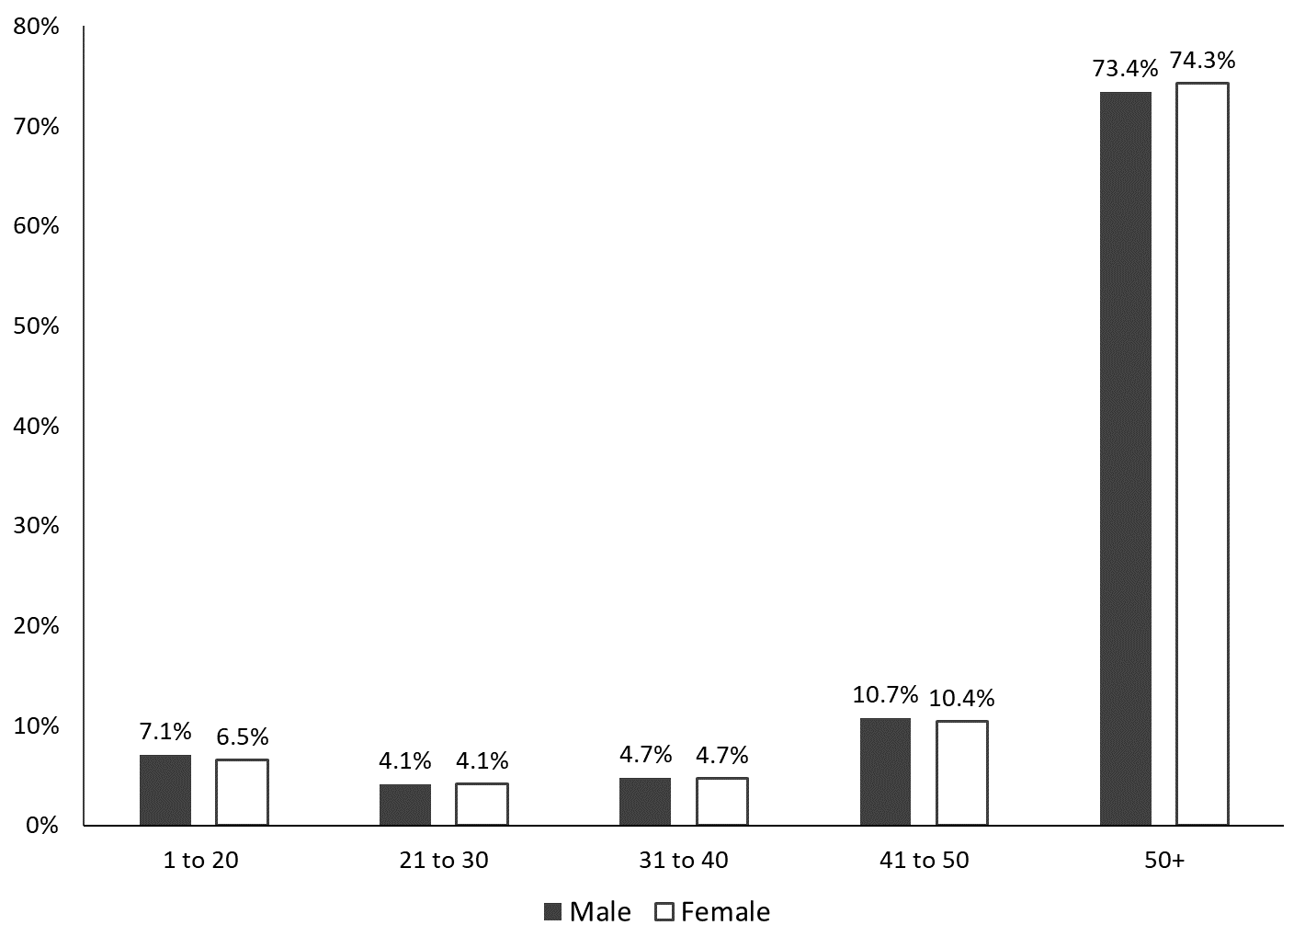
Weeks with a job, and number of jobs held during a tax year, ages 16-64, Great Britain, 2014/15-2018/19
(a) Number of weeks in paid employment held during a tax year, ages 16-64, Great Britain, 2014/15-2018/19
(b) Number of employee jobs held during a tax year, ages 16-64, Great Britain, 2014/15-2018/19
Notes:
We examine the number of weeks that men and women, aged 16-64, were in an employee job over the course of a year, conditional on having at least one job (recorded in a PAYE payslip).
On average, in a given tax year over the period 2014/15 to 2018/19, roughly three-quarters of men (73.4%) and women (74.3%) aged 16-64 in Great Britain, who had at least one job, were in paid employment for nearly the whole year (50+ weeks). However, around one-in-ten (11.2% of men and 10.6% of women) were in paid employment for less than 31 weeks in a year.
Around three-quarters of employees (74.9% of men and 72.2% of women) had a single employer; one-fifth of women (20.1%) and one-sixth of men (17.7%) had two employers over the course of a year; while the remaining 7-8% had at least three different employers.

Slide 19
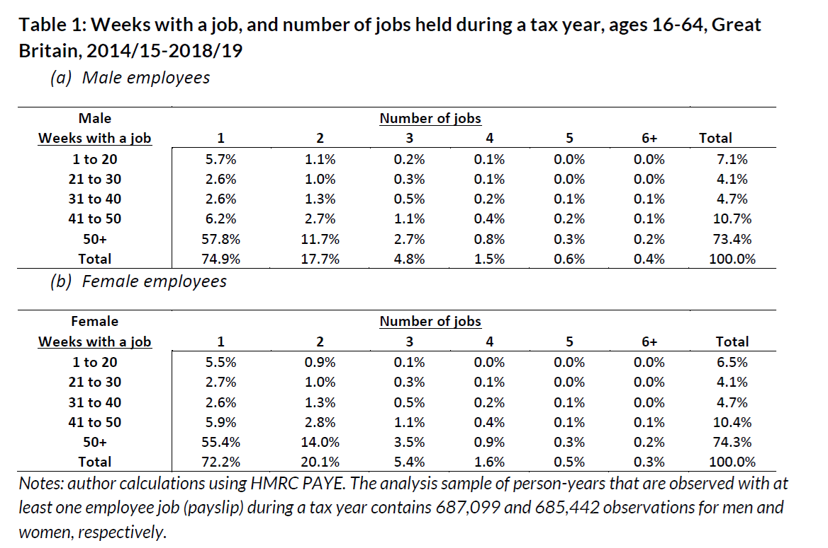
#1: How many jobs, how much earned?
Notes:
This gives us a breakdown by number of jobs held.

Slide 20
#1: How many jobs, how much earned?
What we also looked at:
We consider hourly wage (and gender pay gap) for workers according to their main job, and the pattern of employment over the year (# of jobs and # of weeks)
Bite of the National Minimum Wage / Living Wage : According to ASHE-HMRC, does the National Minimum Wage / Living Wage affect people more who have less “stable” employment (more different jobs and few weeks with any work)?
Is working in some industry sectors associated with less “stable” employment? - we correlate industry-level average hourly wages in April with annual employee earnings from all jobs and employments of the people who worked in those industries in April.

Slide 21
#2: New evidence on gender pay gaps in Great Britain
gender-pay-gap-insights.pdf
What we did:
Using new weights that correct for employer non-response sampling bias in ASHE, we re-estimate the Gender Pay Gap (hourly wages).
Using HMRC data, we look at the gender pay gap in total employee earnings (all jobs and employment spells) over different lengths of period (weekly, monthly, quarterly).

Slide 22
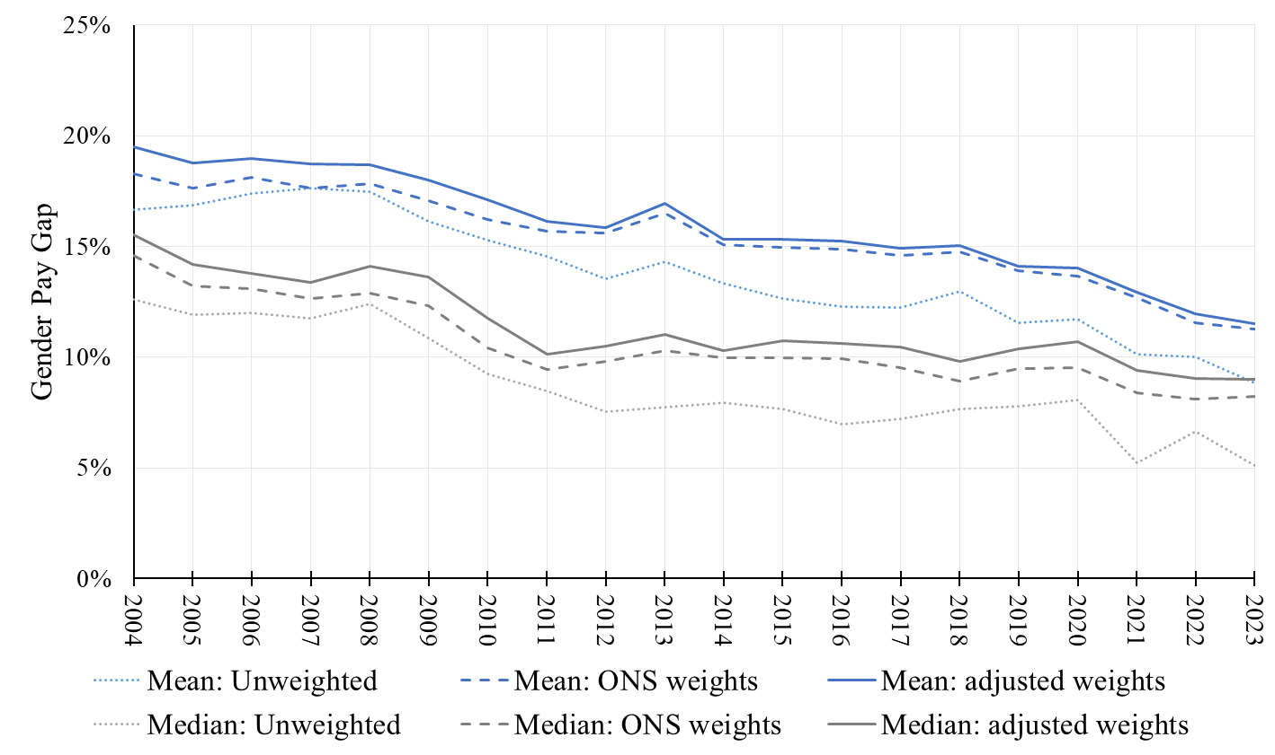
Gender pay gap in Great Britian:
comparison between ONS weights vs adjusted WED weights (ASHE)
Notes:
All three series show convergence in the GPG over this 20-year period.
Gaps in mean pay are higher than those in median pay. The unweighted gaps are lower than those estimated with weights. The focus of our analysis is a comparison of the two weighted series for median pay. The GPG moves in a similar way over time for both series, but the GPG is always larger with the WED-adjusted weights than it is when using the ONS weights, by around 1 percentage point throughout.

Slide 23
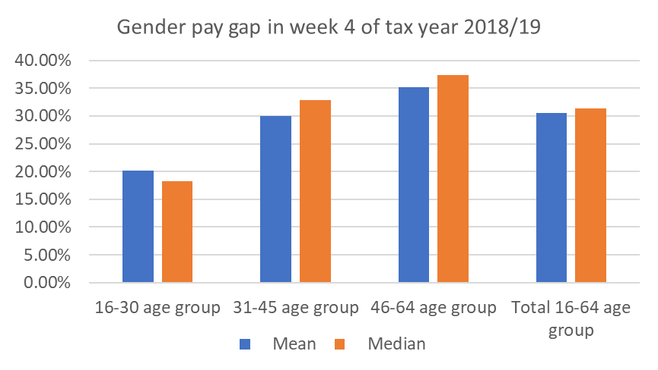
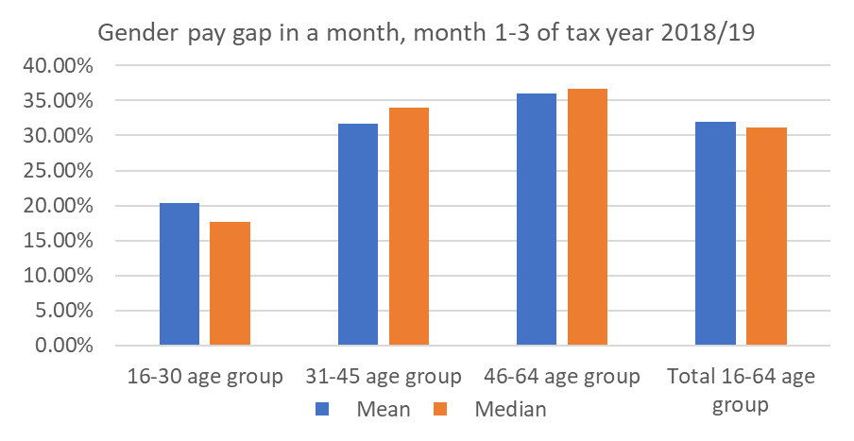
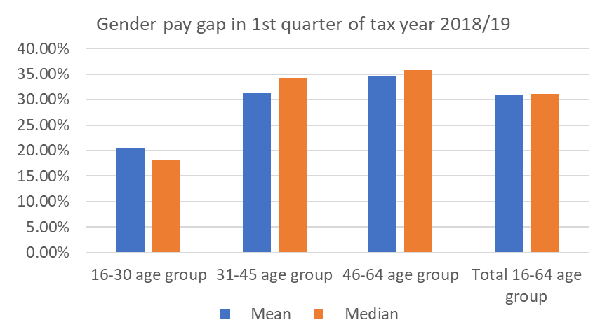
Gender pay gaps in 2018/2019 – PAYE data
Notes:
the ASHE-PAYE analyses provide a new perspective on the GPG, by estimating the gaps in total earnings across all the jobs that employees undertake in a given period
earnings gaps estimates do not appear to be particularly sensitive to the length of the period used, whether it is one week, one month, or a quarter.
Overall GPG stays at 30-31%, and it is 3 times as large as the gap in hourly pay derived from ASHE for the same year.
This suggests that hours of work within a week rather than weeks of work and multiple job holding are the principal factors explaining average earnings gaps, though a deeper analysis looking beyond averages may reveal different patterns

Slide 24
Illustrative research: MWS data

Slide 25
The Migrant Workers Scan
System for HMRC to allocate NINos to non-UK citizens
Current system dates from 2002
Limited information per se:
  sex, age, nationality, previous country of residence
  year of registration/arrival, postcode area at registration
Generally seems good quality data, mostly complete
No information post-registration

Slide 26
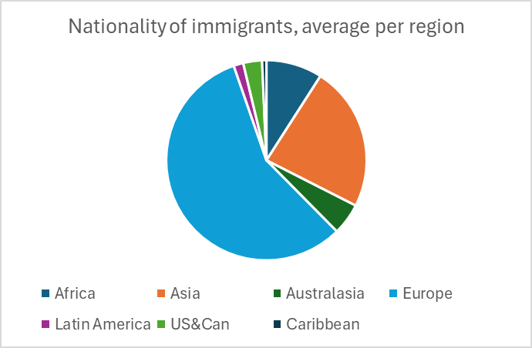
Migrant profiles

Slide 27
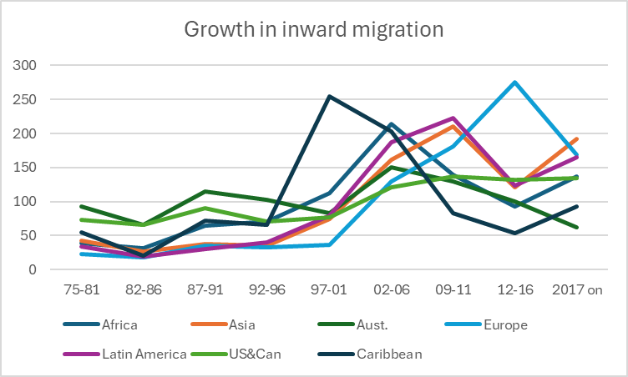
Migrant profiles

Slide 28
Migrant profiles
Arrival year | Frequency | Mean age on arrival | Arrived as an adult | Male | Female married
75-81 | 6,127 | 24.8 | 1.50% | 53.5% | 92.7%
82-86 | 4,707 | 26.3 | 1.30% | 52.0% | 91.7%
87-91 | 8,296 | 26.4 | 1.00% | 52.1% | 75.2%
92-96 | 7,694 | 26.7 | 1.20% | 52.2% | 68.4%
97-01 | 10,123 | 27.0 | 2.00% | 50.0% | 85.2%
02-06 | 25,130 | 27.1 | 1.20% | 53.2% | 84.8%
09-11 | 30,801 | 27.4 | 1.00% | 53.6% | 77.2%
12-16 | 35,147 | 28.5 | 0.80% | 53.6% | 33.3%
2017 on | 28,175 | 29.6 | 0.00% | 51.5% | 15.9%
Total | 156,200 | 27.8 | 0.90% | 52.7% | 58.4%

Slide 29
The Migrant Workers Scan
Interesting but limited set of testable hypotheses
  and only point-of-registration data
Main value is linking to other datasets
  Longitudinal ASHE: wage growth, min wage, location, industry, occupation
  PAYE: wage growth, wage volatility, employment, occ pensions
  SA: sources of income
  all: change at a personal level over time
…but…

Slide 30
Combining ASHE and MWS data
HMRC PAYE
direct: hmrc_id
HMRC MWS
direct: hmrc_id
HMRC SA
Lookup
Lookup
Lookup
ASHE
piden
Age & Gender

Slide 31
A small problem…
 |  | Does the person have a link to the HMRC lookup table?
 |  | No | Yes | Total
Does the person have a link to the ASHE piden? | No | 68,558 | 19,440 | 87,998
 | Yes | 0 | 68,202 | 68,202
 | Total | 68,558 | 87,642 | 156,200

Slide 32
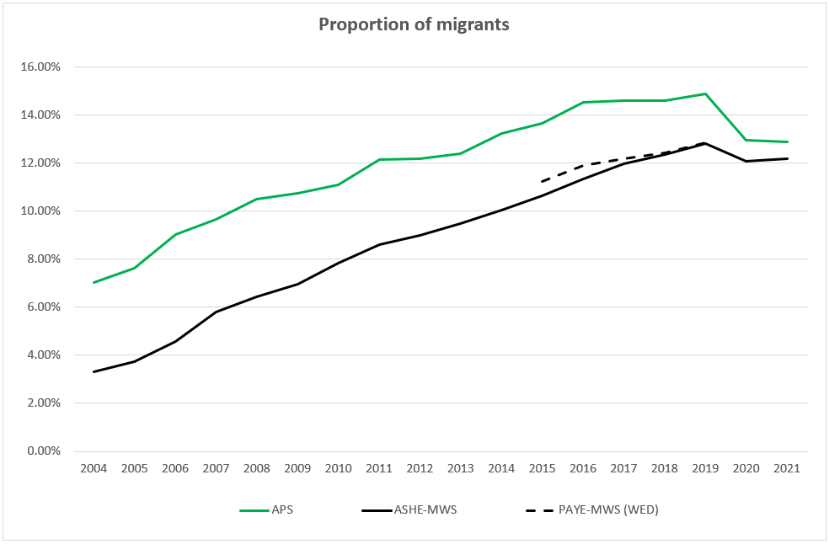
…or not?

Slide 33
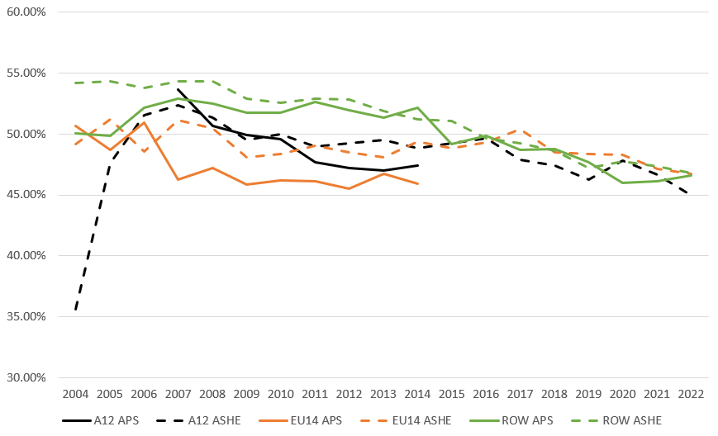
…or not?
proportion of males

Slide 34
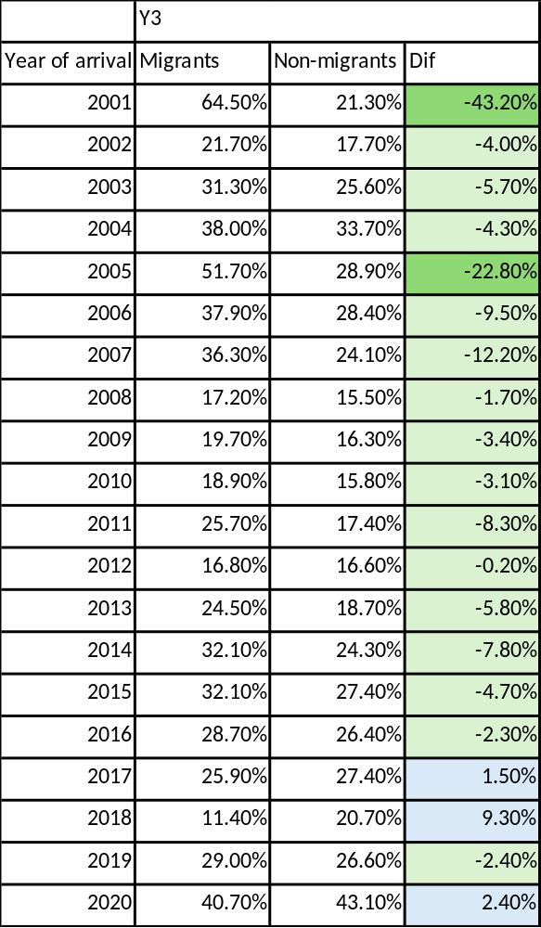
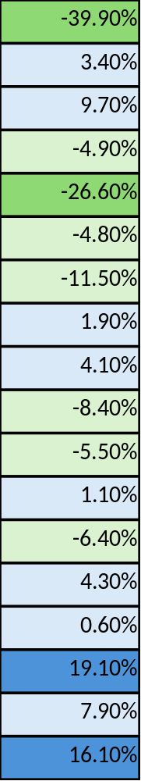
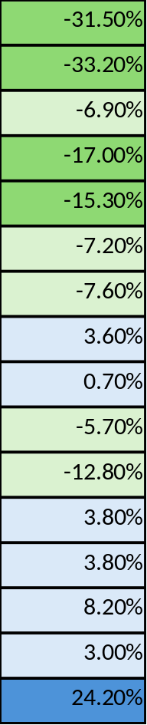
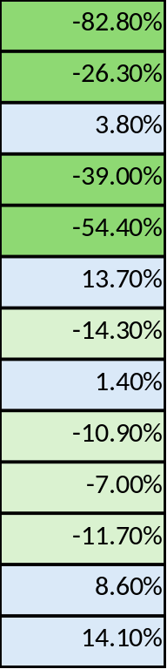
Y3
Y5
Y7
Y10
Wage growth from arrival
for stayers only…

Slide 35
ADRUK perspective

Slide 36


RES Special Session 8: New developments in labour market data
ADR UK / HMRC project
Rosie French
Deputy Director, ADR UK

Slide 37
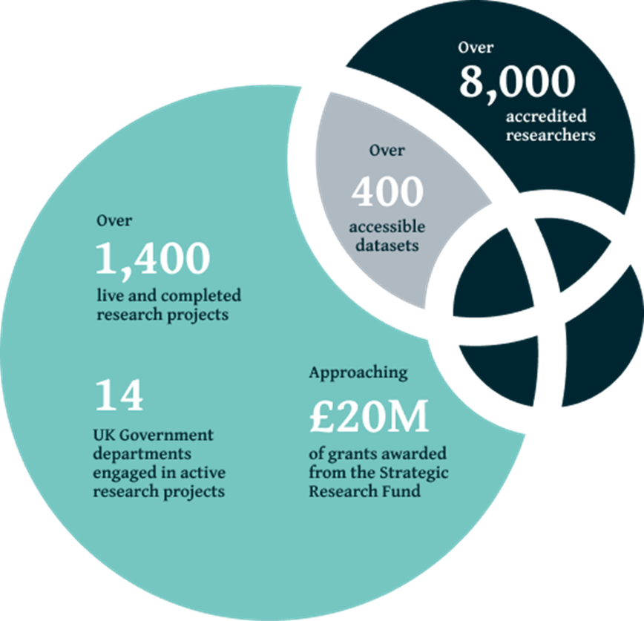

What is ADR UK?
ADR UK (Administrative Data Research UK) is a partnership transforming the way researchers access the UK’s wealth of public sector data, to enable better informed policy decisions that improve lives.
Notes:
ADR UK links together data held by different parts of government and facilitates safe and secure access for accredited researchers to these newly joined-up datasets.
By doing this, we enable both government and researchers to gain a clearer understanding of the UK's most pressing social issues, so that policy can be based upon the best evidence possible.

Slide 38
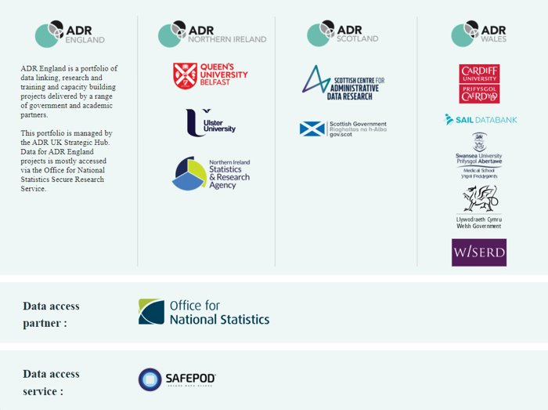

The ADR UK partnership
Notes:
We launched ADR England in 2021 to complete our four-nation partnership. ADR England is a portfolio of data linking and research projects delivered by academic and government partners.

Slide 39
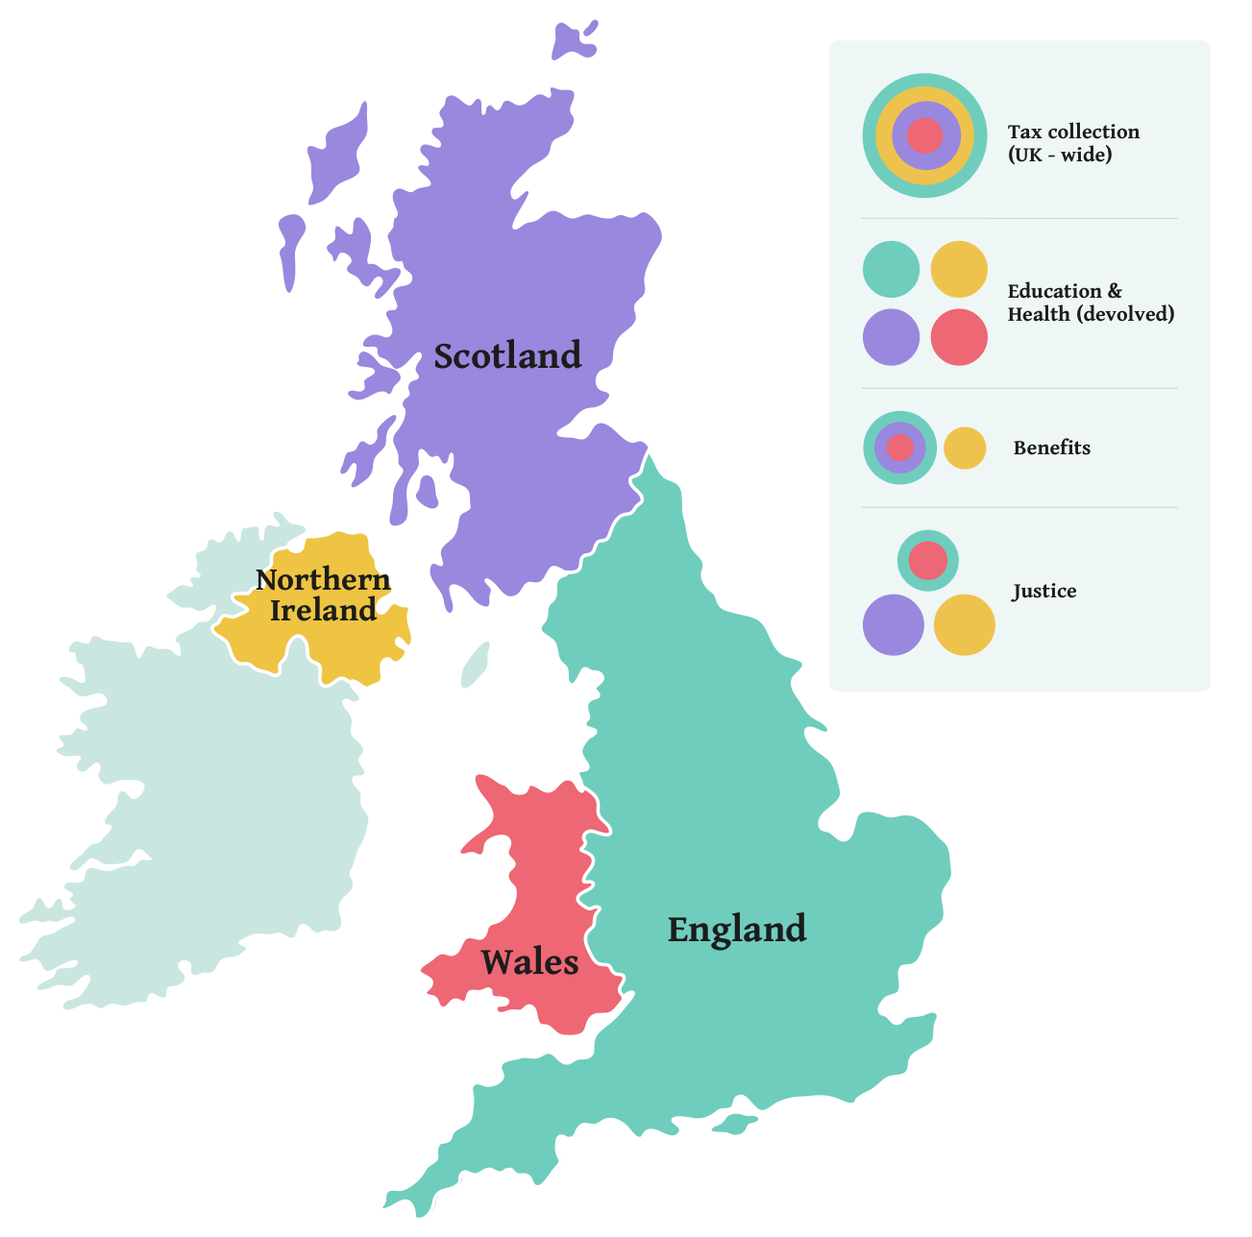
Why were we formed?
Complexities of gaining access to administrative data across the UK meant previous attempts to realise the research potential of this data only worked in the devolved administrations (Scotland, Wales and Northern Ireland).
Notes:
The UK has a mixture of entirely centrally-run government functions (e.g. tax collection), and entirely devolved functions (e.g. health and education), with many somewhere in between (e.g. benefits are Great Britain and NI, and justice systems, which is England and Wales, then Scotland and NI).
To gain access to administrative data for research, there are a lot of data owners to negotiate with, and that is before you start thinking about linking data across these government organisations.
Before the ADR UK programme was set up in 2018, previous programmes had some success in bringing devolved governments together with academic researchers to open up access to data for research. However, the complexities of how the Whitehall departments work – which are the centrally run departments – meant that there was still a wealth of administrative data that was not being used for research, either internally within government, or by the external academic community.

Slide 40

Why is this so difficult in the UK?
No national population register
No standard identification numbers used across services
With non-devolved functions and services, individual government departments are the lawful owners of the data derived from the administrative systems they run; negotiations about data access therefore need to be taken forward with each individual department
Until the Digital Economy Act (2017) was passed, there was no over-arching permissive legal gateway for government departments to use to facilitate research access to data, making it particularly difficult to access linked data

Slide 41

What does this mean for tax data – and what work are ADR UK doing with HMRC?
Enhancing Research Access to HMRC Tax Data
In 2024 ADR UK funded HMRC to conduct a pilot project to explore how to improve access to HMRC’s administrative tax data for research.
Moving beyond the HMRC Datalab model, exploring how more HMRC data can be made accessible through ADR UK’s Trusted Research Environments and linked to other data sources, using DEA legislation.
Outcomes: research carried out using HMRC data can provide valuable insights for HMRC, HM Treasury, and other government departments. This can inform their research priorities, policymaking, and service delivery for the public good.
Notes:
HMRC’s future strategy will look to improve tax research through three broad objectives:
Assess current cataloguing and governance of HMRC’s data used for research purposes against future research needs
Research ways to improve the quality, coverage, and accessibility of HMRC data used by external researchers. Produce costed options for HMRC Datalab’s future strategy and remote access
Facilitate greater engagement between HMRC and the research community to drive improved insights that meet HMRC research needs in the future.
The final report of this project is due to be published this year. This will pave the way for how ADR UK work with HMRC in the future.

Slide 42
Supporting HMRC’s Areas of Research Interest
Modernisation and reform –productivity, potential for efficiencies, supporting more vulnerable customers
Data use – supporting efficiencies, public trust, sharing across departments, connecting academics with practitioners
Connects with ADR UK’s strategic priority for its future phase: Better access to economic linked administrative data to support economic growth and productivity research across the UK.
Notes:
More systematic and efficient linking of health to administrative data over time, allowing a fully rounded longitudinal picture to be built of the factors that affect a person’s life. This will also allow us to better understand the interplay between the health and social factors of people within the population and the government services they interact with.
Further investment in ADR UK infrastructure to support multi-disciplinary research, building on advancements in AI technology to improve how these infrastructures operate.
Better access to economic linked administrative data, informed by HMRC project funded in the current phase, to support economic growth and productivity research across the UK.
LEED – dataset that we want to create could support understanding more about productivity. We know this is a linked data gap and we want to work with HMRC and others to fix this, and make it widely available for all researhers to use.
Include a slide before this about what we’re funding HMRC to do. Project page on website.

Slide 43
Working with the public
ADR UK is dedicated to ensuring people’s data is used in a way that reflects the public’s views and has public support. We have a programme of ongoing public engagement activity to make sure the research we enable accounts for the interests and concerns of its data subjects and the groups it hopes to benefit.
ADR UK and OSR publish research report on public perceptions of public good use of data for research and statistics - ADR UK
Notes:
Difference between operational and research uses of data are clear under the DEA; this has been very useful to us.

Slide 44
Administrative data is an invaluable resource for public good.
We’re using it.

Slide 45
Review and future developments

Slide 46
Wrapping up and discussion

Slide 47
Wrapping up
Early days, still – lots to do
  Only Census/core ASHE outputs so far
  Very large range of potential HMRC hypotheses to be explored
  but limited by time dimension
Lessons learned
  Very slow to acquire data
    many quality issues
    many organisational blocks
    plan projects on delivery date
  Needs combined effort of many people to analyse

Slide 48
Discussion
What next for HMRC data?
  More years in SRS?
  RAPID?
  Something else - LEED?
What next for Census?
  WED linking Census E&W 2021 – back link to Census 2011
  Potential GB dataset
Where should priorities lie?
  more data sources (DWP)?
  longer time series?
  better data?
  curation?

Slide 49
THANK YOU
wagedynamics@uwe.ac.uk

Slide 50
WED Project: How it was meant to work
Research-ready data
Research With Impact
ONS business register
Review
QA
Link
Document
Add common personal IDs
Wage and Employment Spine
wage progression
low-wage labour markets
(Enhanced) ASHE
2011 Census
HMRC data:
1. PAYE
2. Self Assessment
3. Migrant Workers Scan

Slide 51
WED Project: How it worked
Research-ready data
Research With Impact
Review
QA
Link
Document
Add common personal IDs
ONS business register
Wage and Employment Spine
wage progression
low-wage labour markets
(Enhanced) ASHE
2011 Census
HMRC data:
1. PAYE
2. Self Assessment
3. Migrant Workers Scan

