Slide 1

WED Stakeholder Group Meeting
February 28th, 2025
Damian Whittard¹, Van Phan¹, Felix Ritchie¹, Anni Caden¹, Alex Bryson², John Forth³, Carl Singleton ⁴, Rachel Scarfe ⁴
¹ University of the West of England, Bristol. ² University College London, London. ³ City university, London. ⁴ University of Stirling.

Slide 2

Sustainable Research Community
Documentation and metadata - www.wagedynamics.com
Past
Phase 1:
  Enriched ASHE
  Census 2011 linked to ASHE
Present
Phase 2:
  PAYE linked to ASHE
  Self-Assessment linked to ASHE
  PAYE & Self-assessment – standalone
Future
Phase 3 (March 2025)
  Migrant Workers Scan linked to ASHE
Phase 4 (March 2026)
  Census 2021 linked to ASHE

Slide 3
Sustainable Research Community
Knowledge Hub
  WED Community of Interest Group
  Knowledge sharing platform for ASHE users
  Peer to peer collaboration
  Free to register
Features:
  Wiki forums
  Document sharing
  Networking

Slide 4
Update: Datasets
Documentation and metadata - www.wagedynamics.com
Past
Phase 1:
  Enriched ASHE
  Census 2011 linked to ASHE
Present
Phase 2:
  PAYE linked to ASHE
  Self-Assessment linked to ASHE
  PAYE & Self-assessment – standalone
Future
Phase 3 (March 2025)
  Migrant Workers Scan linked to ASHE
Phase 4 (March 2026)
  Census 2021 linked to ASHE

Slide 5
Other highlights in 2024
Publications
Biased Returns to Tenure: The Impact of Firm-Specific Shocks on Base and Non-base Earnings
The Impact of a Rising Wage Floor on Labour Mobility across Firms
Unequal hiring wages and their impact on the gender pay gap.
Revisiting Sample Bias in the UK’s Annual Survey of Hours and Earnings, with Implications for Estimates of Low Pay and the Bite of the National Living Wage
Why Wages Do Not Fall in Jobs with Incomplete Contracts
What can data tell us about wages in the Western Gateway Area?
Stakeholder Engagement
Colloquium on Personnel Economics Conference
Economic Statistics Centre of Excellence (ESCoE) Conference
Flourishing Regions event, as part of Bristol’s Festival ideas
Hosted the ADR UK Research Innovation Workshop at UWE
Wales Institute of Social and Economic Research and Data (WISERD) conference
Work, Pensions and Labour Economics Study Group Special Session
Low Pay Commission Research Symposium
The International Conference on Sustainability, Environment, and Social Transition in Economics and Finance
Futures West Roundtable Event

Slide 6
Sustainable Research Community
Community of interest group
Knowledge Hub - https://www.wagedynamics.com/community-of-interests/
  WED Community of Interests Group
  Knowledge sharing platform
  Peer to peer collaboration
Features:
  Wiki forums
  Document sharing
  Networking

Slide 7
Van Phan, Felix Ritchie, Damian Whittard – UWE
Alex Bryson – UCL
John Forth – City, London
Carl Singleton, Rachael Scarfe – Stirling

Slide 8
‘Enriched’ ASHE
WED Enrichments:
  Additional variables (eg minimum wage, survey dates, persistent definitions)
  Some additional variables from ONS archives (longitudinal job links)
  New weights
  Associated QA and documentation
What can we do with it?
Cross-section and longitudinal studies
Detailed geography/industry/occupation studies
Detailed wage analysis

Slide 9
Some research
Forth et al (2024). The impact of a Rising Wage Floor on Labour Mobility across Firms. Working Paper
Forth et al (2023). How common is low pay in Britain and is it declining? New Findings from linked data. ADR Data Insights
Whittard et al (2023). The perils of pre-filling: Lessons from the UK’s Annual Survey of Hours and Earnings microdata. Statistical Journal of the IOAS.
Stokes et al (2022). Methodology Paper: Cross-sectional weights in ASHE.
Forth et al (2022). Methodology Paper: Longitudinal Attrition in ASHE

Slide 10
ASHE-Census
What is it?
ASHE samples from 2010-2012 linked to the 2011 Census
  Linkage rate: approximately 74%
Personal characteristics from the Census
Limited geography (local authority and above)
What can we do with it?
Combine high-quality ASHE data with
  personal characteristics: education, ethnicity, disability…
  Some family characteristics

Slide 11
Some research
Kaya (2024). Labour market performance and integration of immigrant workers. Working Paper
Whittard (2024). Working towards a greener future: who, where and what for. Working Paper
Phan et al (2023). Accounting for firms in gender-ethnicity wage gaps throughout the earnings distribution. Working Paper
Distefano (2025).

Slide 12
HMRC data
HMRC data, for 1% of employees in the UK who should be represented in the ASHE sample, includes:
  Pay As You Earn (PAYE):
    Those who has employee jobs or occupational pensions
    Details of employment, and payment submission records (monthly/weekly)
    Tax year 2015-2019
  Self-assessment (SA):
    Those who made self-assessment returns
    Details of returns but missing key personal characteristics
    Covers self-employment income & employment income & other types of income
    Tax year 2011-2018
Notes:
The HMRC dataset provides another perspective, covering a broader range of incomes through:
Pay As You Earn (PAYE): Captures monthly and weekly payment records of employees and pensioners.
Self-Assessment (SA): Includes self-employment and other income details.
This data spans tax years 2011–2019 but has its limitations, such as missing personal characteristics."

Slide 13
ASHE-HMRC PAYE & SA
What can I do with it?
  Detailed employment and payslips (monthly/weekly within the gap of ASHE)
  Details of different sources of income from self-employment
Direct analysis
  wage dynamics
  employment dynamics
Combine high-quality ASHE data at an annual level

Slide 14
Combining ASHE and HMRC data
HMRC PAYE
hmrc_id
HMRC SA
Source files
Output files
Output files
Source files
Pay submissions
Paye_weekly_clean
Sa_rtn_tf
Employment
Paye_monthly_clean
Ashe_supplement
Sa_master
Sa_cwh_ar_str
End of year
Paye_weekly_panel
Sa_subset_master
Sa_cwh_ar_rtn_1
Paye_monthly_panel
Sa_cwh_ar_rtn_4
Sa_rtn_3
Lookup
ASHE
Lookup
Sa_rtn_10
piden
Age & Gender
Sa_sa_302
Sa_txp_dtls
Notes:
Paye_weekly_clean: pay slip records for those paid weekly
Paye_monthly_clean: pay slip records for those paid monthly
Paye_monthly_panel: all weekly and monthly pay slip data allocated to months
Paye_weekly_panel: all weekly and monthly pay slip data allocated to weeks
Ashe_supplement: Pay slip data by individual and year, summed across all jobs, including information on the number of jobs, proportion of time in paid employment, labour market activity at the ASHE survey date. Includes data from Employment and EoY files, some of which do not have payslips associated with them.
self-assessment returns
Rtn_tf: main tax return
Cwh_ar_str: short tax return schedule
Cwh_ar_rtn_1: additional information schedule
Cwh_ar_rtn_4: self-employment (partnership) schedule
Rtn_3: self-employment (sole trader) schedule
Rtn_2: employment schedule
Rtn_10: tax calculation schedule
Sa_302: summary file
Txp_dtls: demographic information
The HMRC-PAYE data supplied to the WED project does not contain information on a person’s age and gender, but we recover these from the ASHE panel dataset, so long as a person appears there at least once in the period 1997-2022.

Slide 15
Distinct individuals in HMRC dataset
Tax year | weekly paid | monthly paid | Combined (panel) | SA
2011 | -- | -- | -- | 92,062
2012 | -- | -- | -- | 91,344
2013 | -- | -- | -- | 97,119
2014 | -- | -- | -- | 100,823
2015 | 102,919 | 279,327 | 345,171 | 102,563
2016 | 103,856 | 287,193 | 352,217 | 104,243
2017 | 103,001 | 293,295 | 357,826 | 106,093
2018 | 102,973 | 297,975 | 361,131 | 104,180
2019 | 100,154 | 301,100 | 361,777

Slide 16
Some research
Brewer et al (2024). Measuring earnings volatility with ASHE-PAYE dataset
Reuschke (2025). Self-employment ….

Slide 17
Migrant workers scan
What is it?
  1% of adults registered as migrants
  age & marital status
  country of origin
  date of arrival and registration
What can I do with it?
  Add migration information into ASHE/HMRC data

Slide 18
MWS
Age
Previous residence
Nationality
Date of registration
Date of arrival
Gender
Postcode area
hmrc_id
HMRC
Lookup
ASHE
Lookup
piden
Age & Gender

Slide 19
Migrant Scan Workers
bornyear | Freq. | Percent | Cum.
1903-1929 | 364 | 0.23 | 0.23
1930-1949 | 3,763 | 2.41 | 2.64
1950-1959 | 10,596 | 6.78 | 9.43
1960-1969 | 21,138 | 13.53 | 22.96
1970-1979 | 34,697 | 22.21 | 45.17
1980-1989 | 50,919 | 32.6 | 77.77
1990-1999 | 31,610 | 20.24 | 98.01
2000-2006 | 3,113 | 1.99 | 100
Total | 156,200 | 100

Slide 20
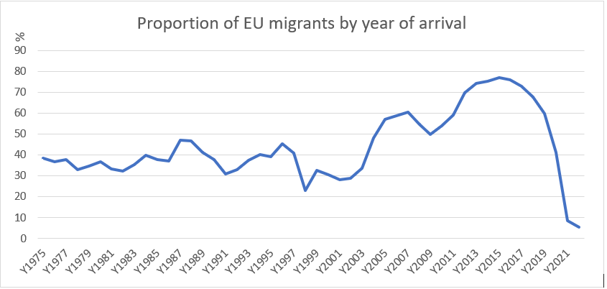

Slide 21
Expected
2022
2024
2025
2026
‘Enhanced’ ASHE
ASHE - PAYE & SA
ASHE-Census 2011
ASHE - Migrant Scan Worker
ASHE-Census 2021

Slide 22
ASHE-Census 2011 linked dataset:
  74% of ASHE respondents in 2011 have linked data from Census 2011
  Data released via SRS in July 2023
  Generating research on migrant wage gaps, disability pay gap, green jobs
  But …. no linked data for new entrants into ASHE
  Some personal characteristics change over time (e.g. disability status)
UKRI funding WED/ONS to link ASHE to Census 2021
  ONS currently linking the data using new methods (demographic index)
  WED team will QA and document
  Aim: release ASHE-Census 2021 dataset in Summer 2025
  Longitudinal ASHE-Census dataset (ASHE + Census 2011 + Census 2021) by Winter 2025
  Users supported with training and networking events

Slide 23
^{Community of Interest}

Slide 24
Sustainable Research Community
Community of Interest group
  https://www.wagedynamics.com/community-of-interests/
Knowledge Hub
  https://khub.net/group/wage-and-employment-dynamics-research-group/

Slide 25

Sustainable Research Community

Slide 26
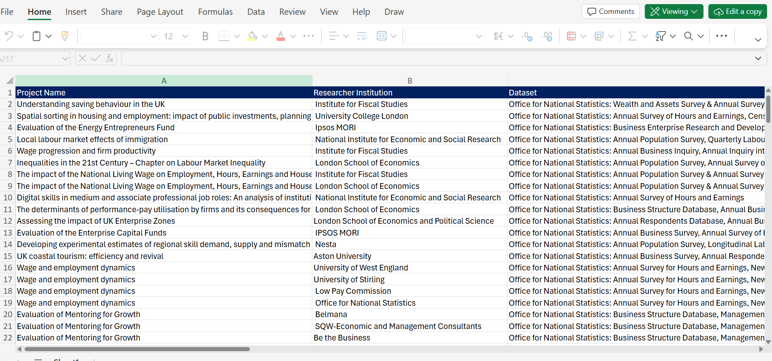
Sustainable Research Community

Slide 27
Sustainable Research Community
Knowledge Hub
  WED Community of Interest Group
  Knowledge sharing platform for ASHE users
  Peer to peer collaboration
  Free to register
Features:
  Wiki forums
  Document sharing
  Networking

Slide 28
Sustainable Research Community
Knowledge Hub
  WED Community of Interest Group
  Knowledge sharing platform for ASHE users
  Peer to peer collaboration
  Free to register
Features:
  Wiki forums
  Document sharing
  Networking

Slide 29


Slide 30
Data Insights:
#1: How many jobs, how much earned?
#2: New evidence on gender pay gaps in Great Britain
Rachel Scarfe, Carl Singleton, John Forth, Alex Bryson, Van Phan,
Felix Ritchie, and Damian Whittard
January 2025
www.wagedynamics.com

Slide 31

Published at: https://www.adruk.org/our-work/data-insights/

Slide 32
#1: How many jobs, how much earned?
What we did:
Using the 1% ASHE Sample Population, we count up the number of weeks in a tax year that people have at least one employee job.
We also count up the number of different jobs (employers) that people have in a year.
We can look at these employment patterns by age and gender.
Gives a rough sense of how we can now go much further than ASHE (and household surveys) to understand wage, employment, and job dynamics,
Also suggests how the data can be used to and construct complex employment histories variables for ASHE people.

Slide 33
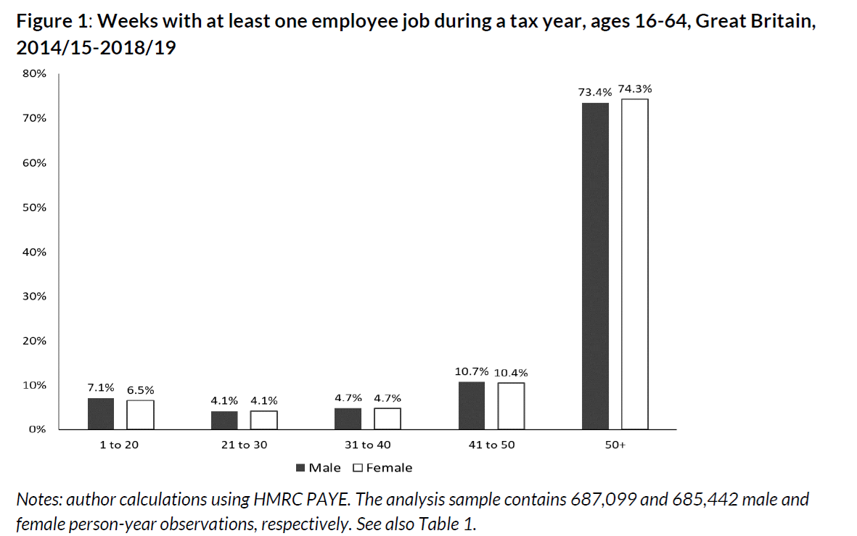
#1: How many jobs, how much earned?

Slide 34
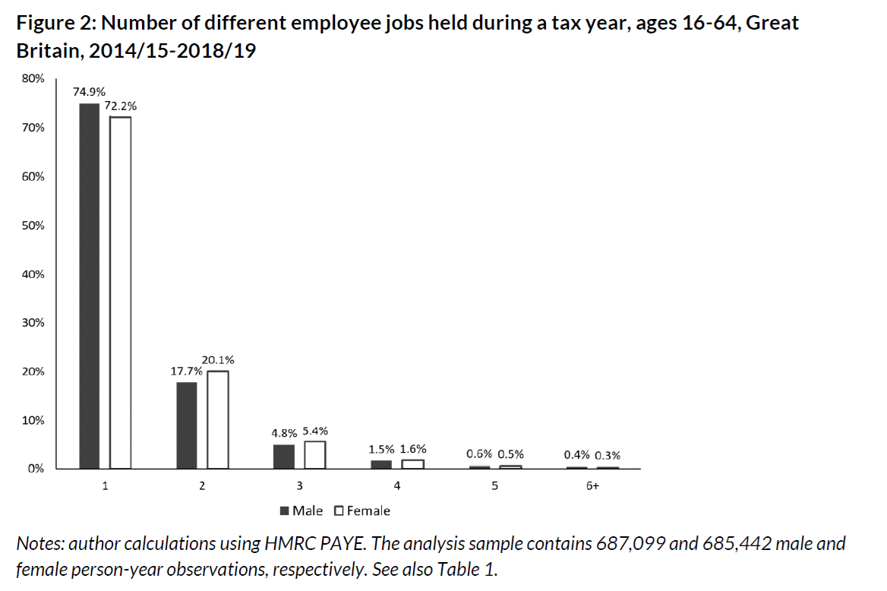
#1: How many jobs, how much earned?

Slide 35
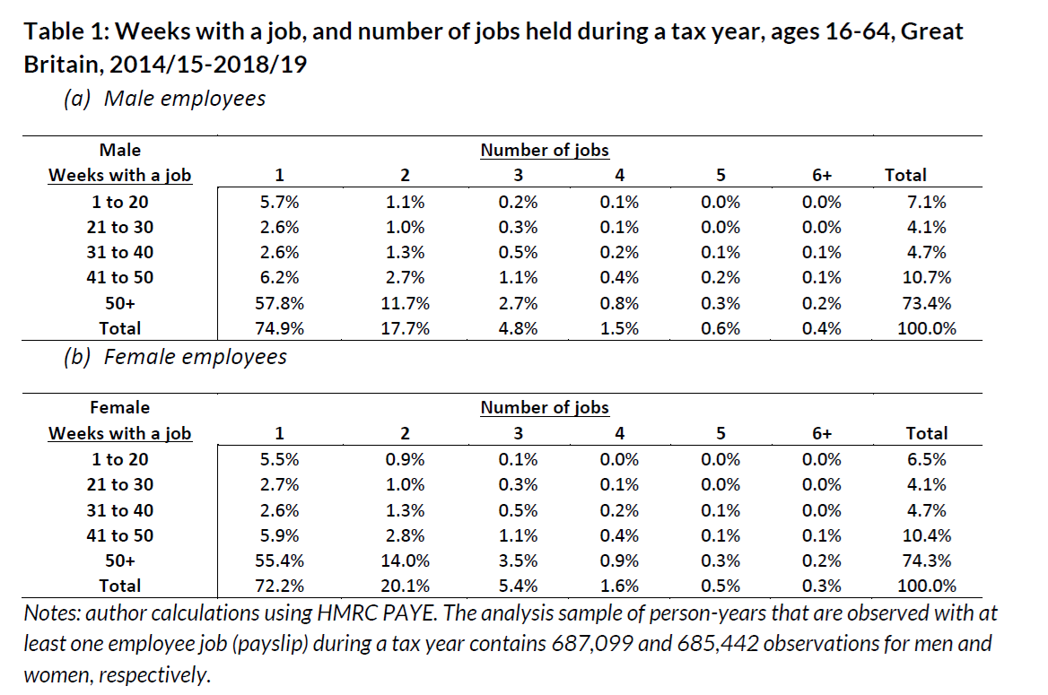
#1: How many jobs, how much earned?

Slide 36
#1: How many jobs, how much earned?
What we also looked at:
We consider hourly wage (and gender pay gap) for workers according to their main job, and the pattern of employment over the year (# of jobs and # of weeks)
Bite of the National Minimum Wage / Living Wage : According to ASHE-HMRC, does the National Minimum Wage / Living Wage affect people more who have less “stable” employment (more different jobs and few weeks with any work)?
Is working in some industry sectors associated with less “stable” employment? - we correlate industry-level average hourly wages in April with annual employee earnings from all jobs and employments of the people who worked in those industries in April.

Slide 37
#2: New evidence on gender pay gaps in Great Britain
What we did:
Using new weights that correct for employer non-response sampling bias in ASHE, we re-estimate the Gender Pay Gap (hourly wages).
Using HMRC data, we look at the gender pay gap in total employee earnings (all jobs and employment spells) over different lengths of period (weekly, monthly, quarterly).

Slide 38
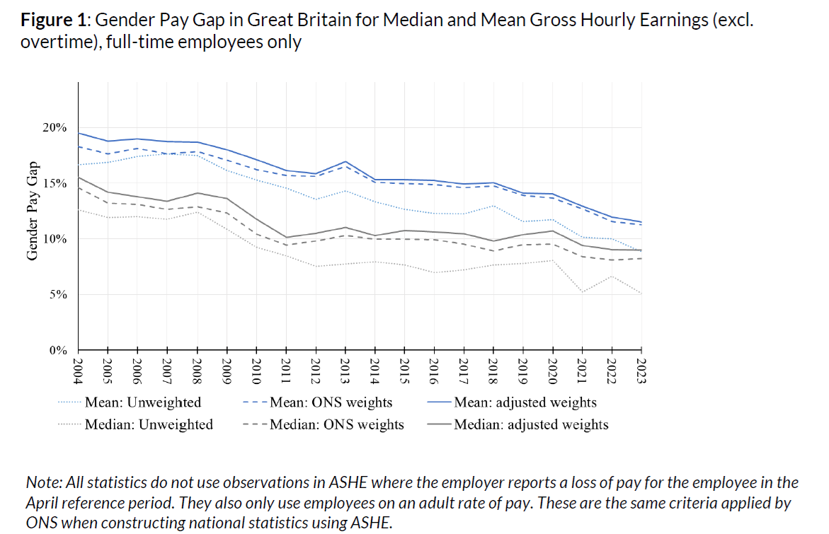
#2: New evidence on gender pay gaps in Great Britain

Slide 39
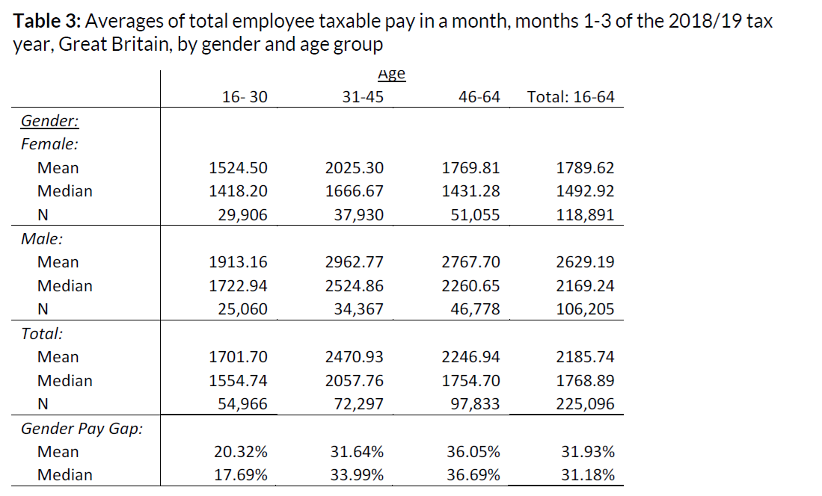
#2: New evidence on gender pay gaps in Great Britain

Slide 40
ESRC Funded Projects
using the ASHE

Slide 41

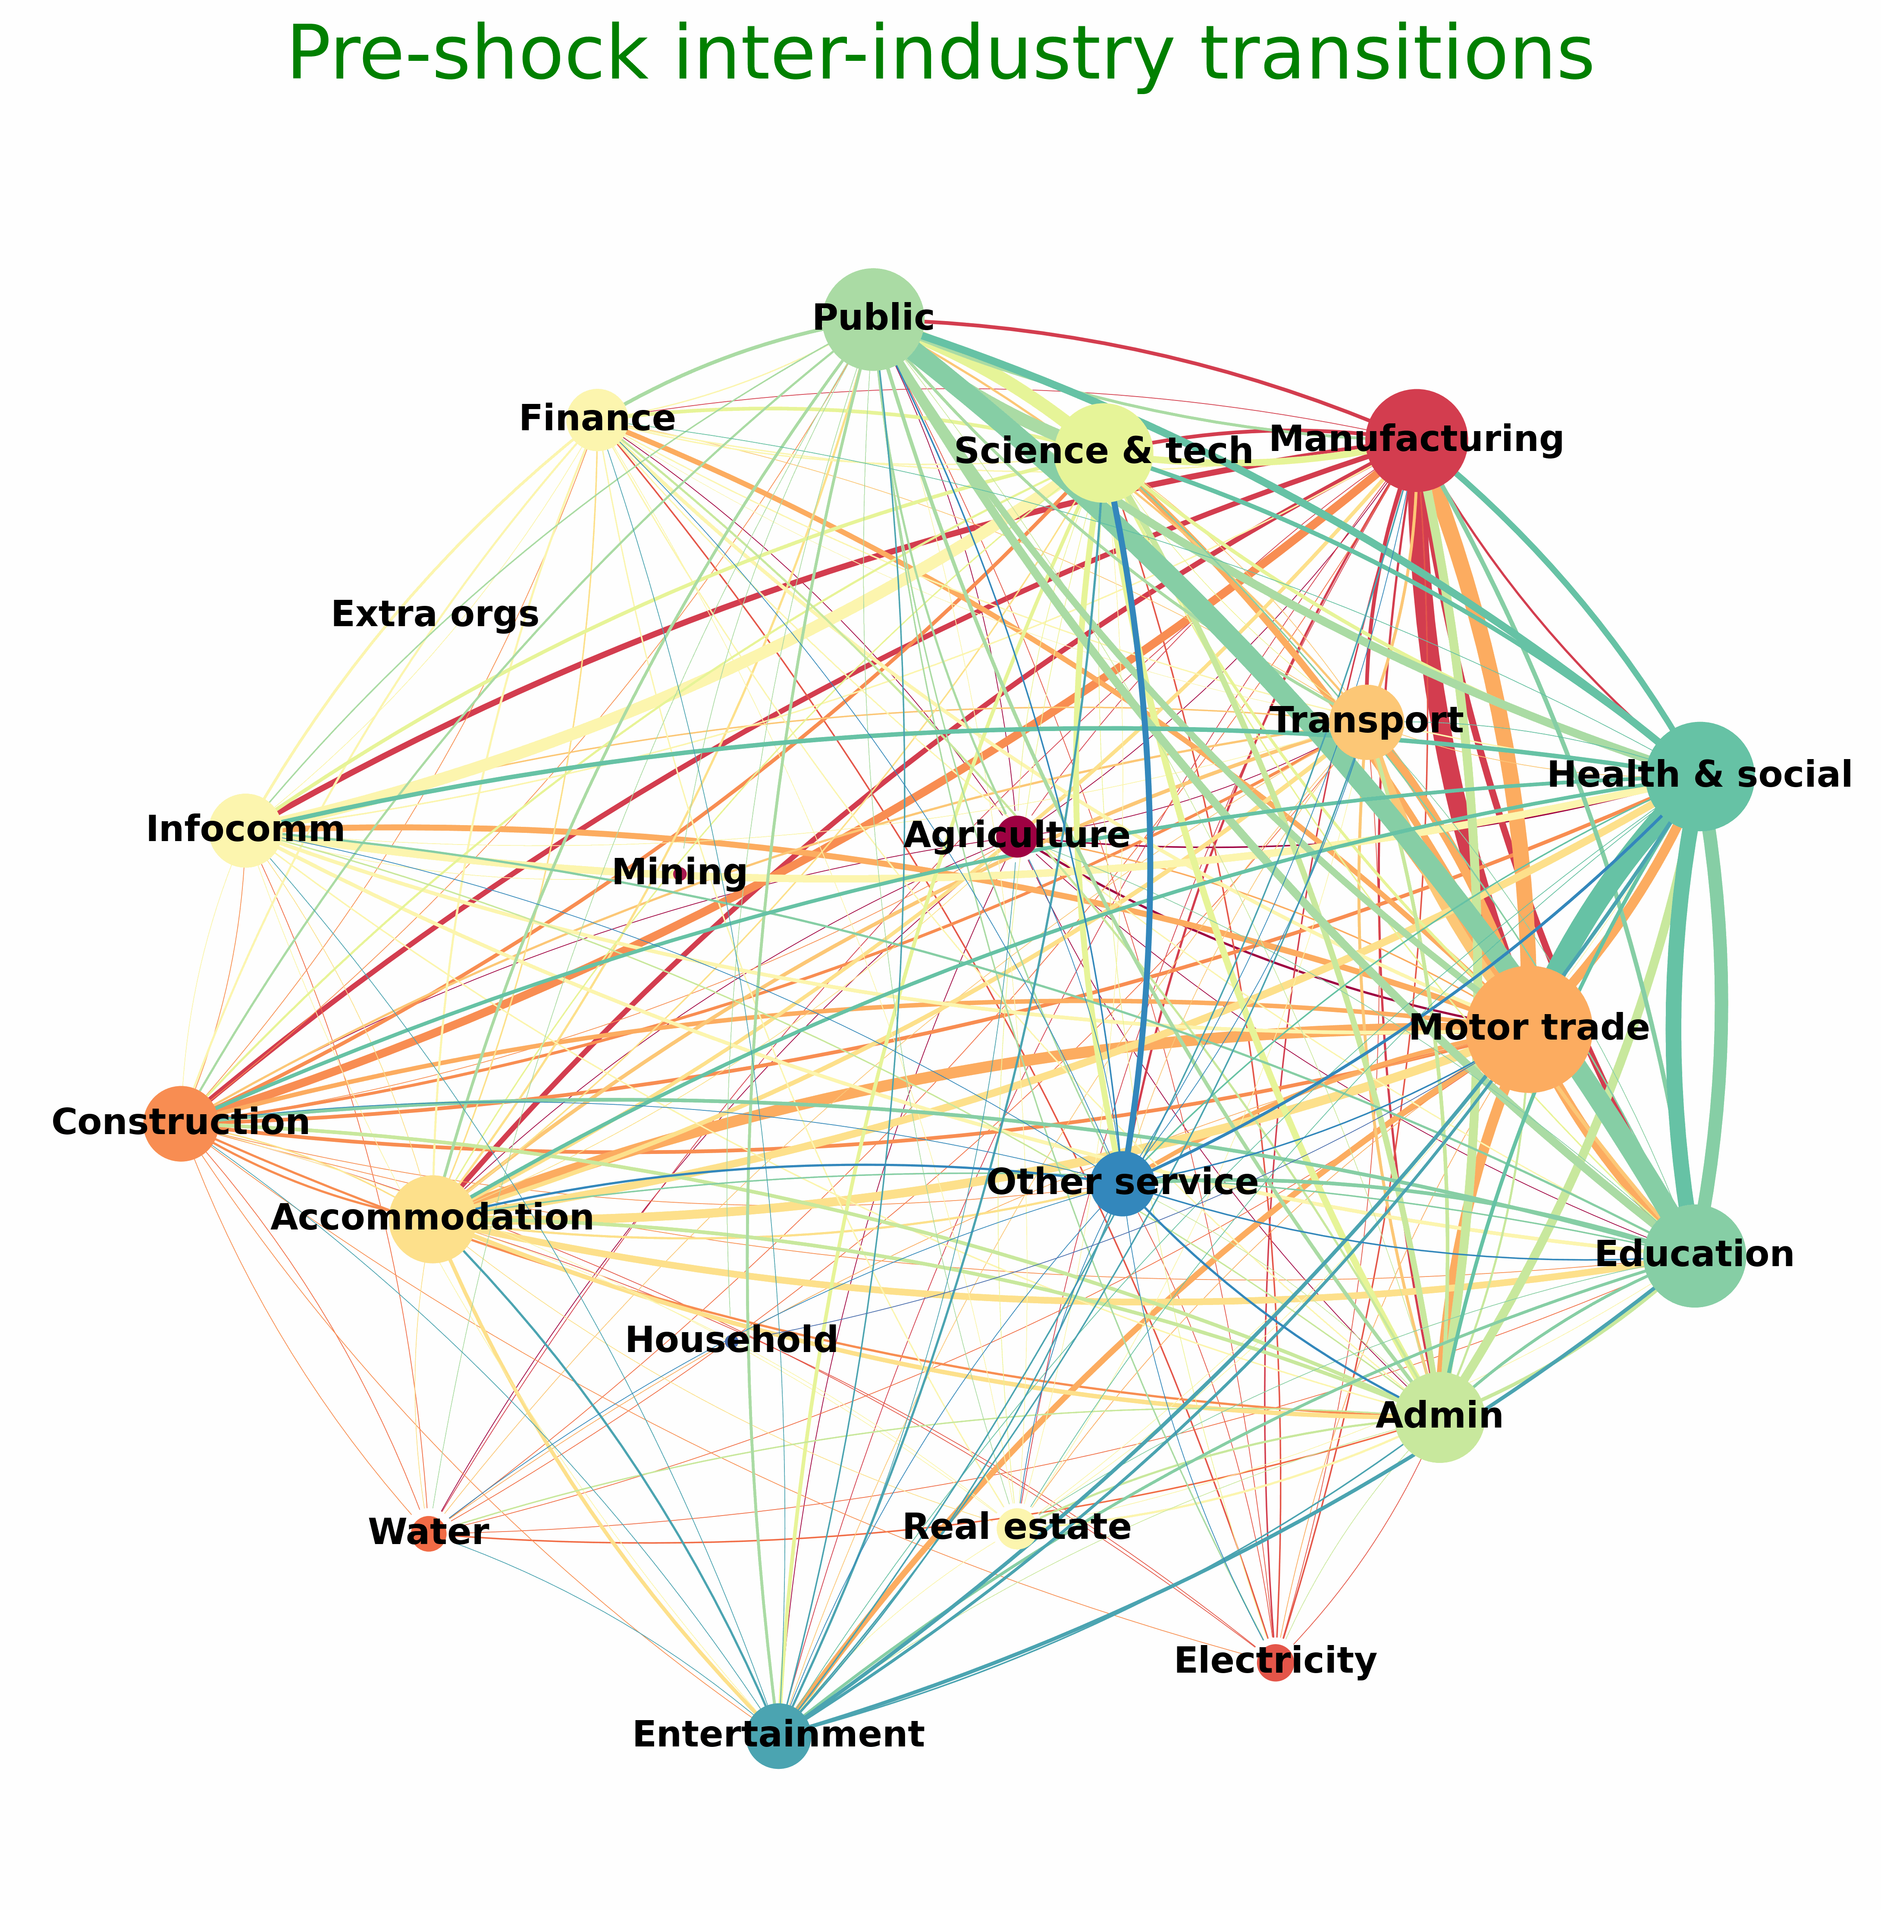
Introduction
Dr Kathyrn (Kat) Fair
Senior Research Associate, The Alan Turing Institute
Data Science Academic Advisor, Department for Business and Trade
Background
Applied Mathematics PhD
Agent-based modelling
Network Science
Labour & skills

Slide 42
Measuring inequality-driven skills gaps in the UK labour market (ASHE-Census)
Aim:
To understand how structural inequalities shape the skillset of the UK labour market.
Research questions:
How does hiring discrimination impact the skills UK workers possess?
How do these impacts influence outcomes for individual workers (e.g. earnings)?
How do these impacts affect UK industries (e.g. in terms of lost productivity)?
Methods:
Agent-based model of the UK labour market, describing job-to-job transitions
and capturing worker skills development.

Slide 43

Dr Daniel Derbyshire
Factors affecting the disability pay gap in England?
This work is funded by Administrative Data Research UK and uses data from the ASHE-2011 Census (https://doi.org/10.57906/80f7-te97) which is owned by the Office for National Statistics.

Slide 44
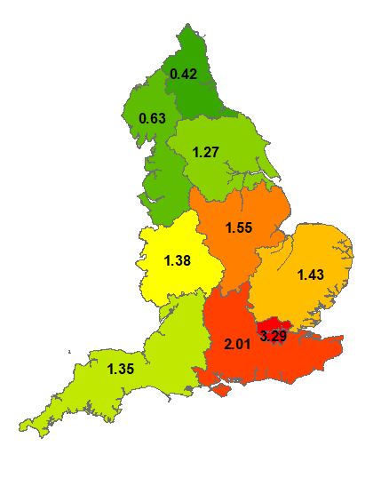
Disability Pay Gaps
Standard Occupation Classification (2010)* | Pay Gap as…
 | £/hr | %
1. Managers, directors and senior officials | 1.52 | 8.58
2. Professional occupations | 0.74 | 4.07
3. Associate professional occupations | 0.58 | 4.17
4. Administrative and secretarial occupations | 0.36 | 3.65
5. Skilled trades occupations | 0.00 | 0.00
6. Caring, leisure and other service occupations | -0.10 | -1.26
7. Sales and customer service occupations | -0.05 | -0.69
8. Process, plant and machine operatives | 0.60 | 6.81
9. Elementary occupations | -0.02 | -0.26
All Occupations | 0.96 | 9.38
*https://www.ons.gov.uk/methodology/classificationsandstandards/standardoccupationalclassificationsoc/soc2010NS?

Slide 45
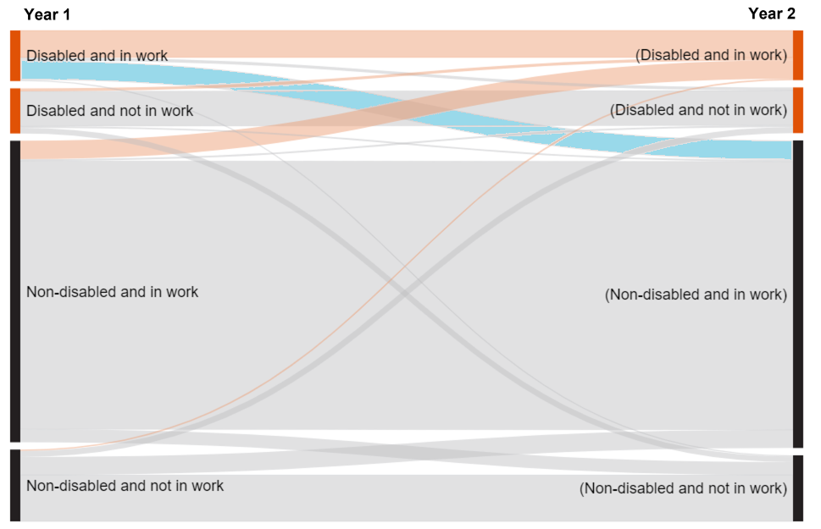
Disability Flows
2015
2015
2014
Disabled
2014
Not Disabled
Disabled
Not Disabled
Not Disabled
Disabled
Years | Disability status | Number of people
2014 to 2015 | Total | 40,118
 | Remain disabled | 4,999
 | Moved from disabled to not disabled | 2,177
 | Remain not disabled | 30,464
 | Move from not disabled to disabled | 2,052
From one year to the next…
Approximately 2.4m non-disabled people become disabled….
And 2.4m disabled people become non-disabled…
Source: ONS ‘Employment of Disabled People’, Table FLW001.

Slide 46
Question
All current analysis only uses the 2011 link year because of uncertainty around disability status in other years
To maximise value of ASHE-Census, we want to use other years too
Current idea:
  Simulate disability status for 2012 onwards using a state transition model and known transition probabilities
Open to alternative suggestions

Slide 47
Mimosa Distefano
I am a post-doc at the Centre for Economic Performance (LSE). I obtained my PhD in Economics at University College London in 2022
I just started my ADR UK fellowship working on the ASHE linked with the 2011 census dataset
My project studies how job opportunities for workers with different levels of formal education compare across areas and the role of city size in affecting these opportunities

Slide 48
Local area size and job-to-job mobility
Adopting difference-in-differences analysis and exploiting firm closures, my project aims to answer the following research questions:
Do differences in local economic opportunities affect workers in the same way?
Do differences in firm productivity across local areas matter for workers with more formal education and workers with less?
My main questions:
What do you think are the most salient policy questions/issues in this area?
Which output would you be most interested in?

Slide 49


Multiple employment using ASHE/HMRC SA data
Darja Reuschke (University of Birmingham), ADR UK fellowship
Research questions
Differentiation between multiple (employee) jobs & mixing employee job with self-employment
Motivations and influencing factors:
Low paid jobs?
Time-based underemployment?
Job insecurity?
Business cycle?
Local labour markets?
Data
Linked ASHE & HMRC SA for tax years 2011-2018 (ASHE years 2010-2017)
Multiple jobs in ASHE 2007-2022 (for more recent insights)
Linkage of geographical data: regional/local unemployment, GDP, median wage
Analytical strategy
Individual-level longitudinal dataset/s
Entry models into multiple jobs & into mixed employment with individual fixed effects
By gender

Slide 50
Some preliminary findings and policy implications
Multiple jobholding and mixing employee jobs with self-employment are different
Multiple jobs: low paid jobs due to low work hours and not low hourly wages both for women and men
Job insecurity (temp jobs) does not drive multiple jobs; quite the opposite for mixing employment
One consistent finding: public sector employment (explanation?)
Policy implications: jobs that offer enough work hours

Slide 51
Project Title: Employment Journeys of People working in the Community Care Sector
I am Ramakrishnan Radhakrishnan, PhD Student supervised by Prof. Peter McMeekin, Northumbria University and Prof. John Wildman, Newcastle University.
Aging Population
Restrictive Labour Supply
Low Paid Sector
Low-skilled sectors (Anne green, 2014)
(Manthorpe et al., 2010) mention that International workers are often perceived as more reliable and productive than local workers but may use social care as a stepping stone to other employment.
The result that social care employment is used as a stepping stone to find other employment also implies that the social care workforce in the UK faces significant challenges with high turnover and vacancy rates, particularly among frontline staff (Vadean & Saloniki, 2020).

Slide 52
General Specifics and Objectives (Not exhaustive):
To build a panel data set that allows trends to be estimated at a national (England) level.
To estimate, using various statistical models, especially panel data models, the association between the retail sector and the social care employment dynamics among various others.
To consider the evidence generated considering previous research into employment trends
To make recommendations for further research based on a panel of individuals to further explore the relationships between employment in the social care sector or alternatives.

