Slide 1
The Impact of a Rising Wage Floor
On Labour Mobility Across Firms
John Forth, Carl Singleton, Alex Bryson, Van Phan,
Felix Ritchie, Lucy Stokes and Damian Whittard
WPEG Annual Conference
Sheffield
16 July 2024

Slide 2
Acknowledgements and disclaimer
We gratefully acknowledge ADR UK (Administrative Data Research UK) and the Economic and Social Research Council (Grant No. ES/T013877/1) for funding.
The work is based on analysis of the research-ready datasets from the Annual Survey of Hours and Earnings (ASHE):
  Office for National Statistics (2022) Annual Survey of Hours and Earnings - UK, dataset, ONS SRS Metadata Catalogue, DOI: 10.57906/x25d-4j96
This work was produced using survey data accessed through the ONS Secure Research Service. The use of the ONS data in this work does not imply the endorsement of the ONS or data owners in relation to the interpretation or analysis of the statistical data. This work uses research datasets which may not exactly reproduce National Statistics aggregates. National Statistics follow consistent statistical conventions over time and cannot be compared to these findings.

Slide 3
Motivation
In April 2016, the UK wage floor for employees aged 25+ increased by 50 pence/hour – largest increase for a decade – raised the % of jobs paid at the minimum from 5% to 8%
Standard competitive models predict negative employment effects because fewer job matches are profitable, yet very limited evidence of dis-employment in aggregate (e.g. Giupponi et al, 2024, JoLE)
One further potential impact - subject to limited research thus far – is on job-to-job mobility: movement of workers across firms
Rising wage floor may lead to an increase in labour mobility – less productive firms contract, workers are laid off, then hired by more productive firms (see Dustmann et al, 2022, QJE, for evidence from Germany)
But a rising wage floor also lowers the expected value of on-the-job search for those who would otherwise feel underpaid -> reducing mobility and raising low-wage job tenure (see Dube et al, 2007, ILRR; Dube et al, 2016, JoLE, for evidence from the US)
Notes:
Giupponi et al use a bunching estimator to look at impact of introduction of NLW on the number of jobs at different points in the wage distribution
If no employment effects, how have employers adjusted? Raised prices, increased effort or reduced profits. Any negative employment effects that have been found tend to be limited to female part-time workers. Many of these work in retail, where competitive conditions make price rises difficult and there are clear opportunities for K/L substitution.

Slide 4
Our contribution
We use a linked employer-employee data (ASHE) with a difference-in-difference (DiD) estimator to evaluate the impact of the introduction of the NLW on labour mobility among workers aged 25+ in the UK
Job mobility defined as a change of employer among those who remain employed
Policy is national (no regional variation as per US) so our DiD uses controls higher up the wage distribution
We examine the sensitivity of our results to various re-specifications of treated and control (e.g. accounting for the possibility of spillovers)
We find no evidence that the increase in the wage floor changed rates of job-to-job mobility among low paid workers. This provides further evidence of the seemingly benign effects of minimum wage policy on employment dynamics in the UK
Notes:
Note a LATE, because that would be estimated only for those whose wages actually go up to the new NMW

Slide 5
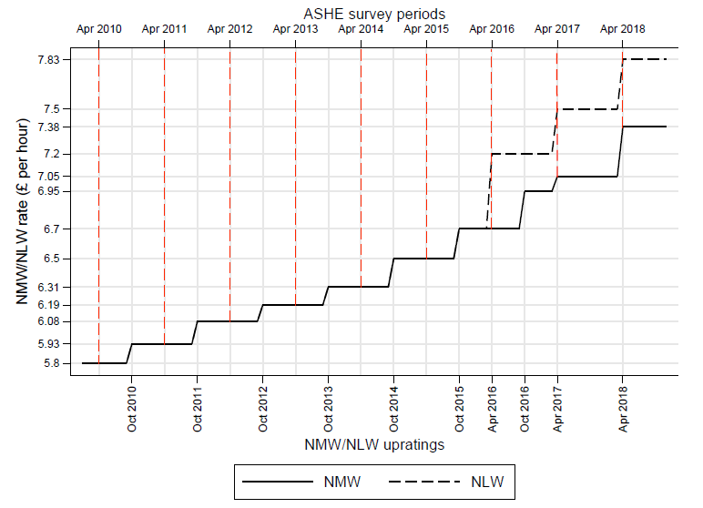
Changes in the wage floor for workers aged 21+
NLW for age 25+
Source: Aitken et al (2019)
Notes:
Follow the black line – shows uprating each October. Typically 10-20p each time.
Oct 2015 was the last time that the wage floor was uprated in October. Increase of 20p to £6.70 (around 7.85 Euros)
At this point, gov announced wage floor would rise in April from now on. And announced that in April 2016, minimum wage for workers aged 25+ would increase from £6.70 to £7.20. This new rate for workers aged 25+ would be called the National Living Wage. Younger workers would see more modest increases.
We are focusing on what happened in 2016
Red lines show the dates for which we have observations on low wage workers (essentially each April).
Because the policy was announced in October, and there may be anticipation effects, we are going to assume introduced in 2015/16. But because of possibility of delayed reaction, also look at 2016/17. Compare with 2013/14 and 2014/15.
Note that the wage floor changes each year. So effectively comparing impact of large increase with impact of smaller increases in other adjacent years.
Later changes:
Apr 2021 – extended to 23+
Apr 2024 – extended to 21+

Slide 6
Data
Annual Survey of Hours and Earnings (ASHE), undertaken by the UK Office for National Statistics
Based on a representative 1% sample of all employees, selected via last two digits of NI #
Pay and hours data is provided by their employer -> wage data is of high quality; used for official estimates of low pay
Offers around 150,000 obs in total p.a.; around 7,000 obs at the wage floor p.a.
We focus on the population of workers in employee jobs at t and t+1
Each job has a unique firm identifier – enables clean identification of cross-firm mobility (not relying on employees’ self-reported tenure)
Sampled employees should be observed in each year they hold an employee job
But the response process -> excess panel attrition (25% vs 8%) -> WED longitudinal weights
Notes:
Focus on workers in employee jobs at t and t+1
Allows us to home in on job-to-job mobility for those who remain in work. Other papers look at dis-employment (Giupponi), or transitions to other states (e.g. unemployment, inactivity).
We focus on the comparative advantage of ASHE, which is that it has a clean firm ID.
One limitation is panel attrition. We test sensitivity to use of WED longit weights.

Slide 7
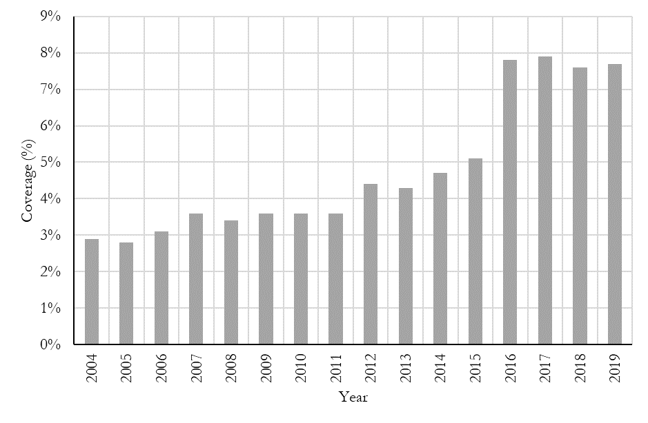

New wage floor covers more employee jobs
Notes:
Substantial equalisation of wages

Slide 8
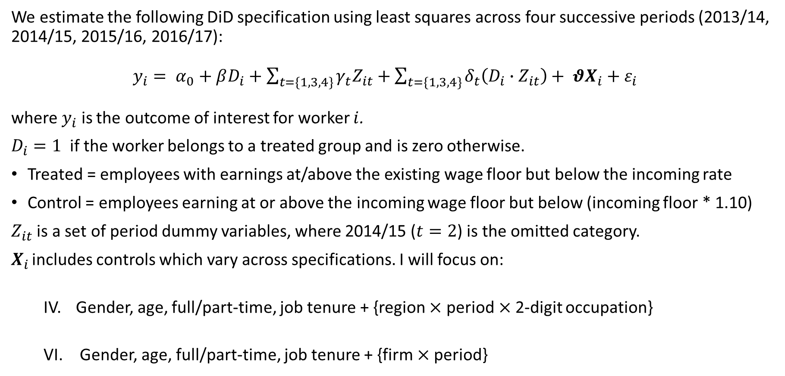
Methods
We estimate the following DiD specification using least squares across four successive periods (2013/14, 2014/15, 2015/16, 2016/17):
$y_{i}= α_{0}+βD_{i}+\sum_{t=\{1, 3,4\}}{γ_{t}Z_{it}}+\sum_{t=\{1, 3,4\}}{δ_{t}\left(D_{i}∙Z_{it}\right)}+ θX_{i}+ε_{i}$
where $y_{i}$ is the outcome of interest for worker $i$.
$D_{i}=1$ if the worker belongs to a treated group and is zero otherwise.
Treated = employees with earnings at/above the existing wage floor but below the incoming rate
Control = employees earning at or above the incoming wage floor but below (incoming floor * 1.10)
$Z_{it}$ is a set of period dummy variables, where 2014/15 ($t=2$) is the omitted category.
$X_{i}$ includes controls which vary across specifications. I will focus on:
  IV. Gender, age, full/part-time, job tenure + {region $×$ period$×$2-digit occupation}
  VI. Gender, age, full/part-time, job tenure + {firm $×$period}
Notes:
Two periods before the policy change and two after. Go back to slide 4.
Note: Intro of NLW relative to other NMW rises
Controls: we have six specifications, ultimately. Our preferred specs (IV) and (VI).

Slide 9
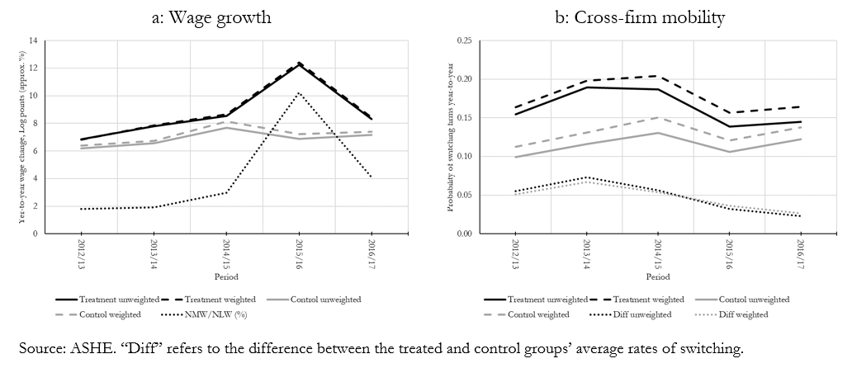
Wage growth and cross-firm mobility: raw time trend
Notes:
We have an extra year in these charts – ignore. Not in regressions.
We first check that wages did actually increase as a result of the rising wage floor – test of compliance with the policy.
Application of weights doesn’t change the picture – true for regression analysis too

Slide 10
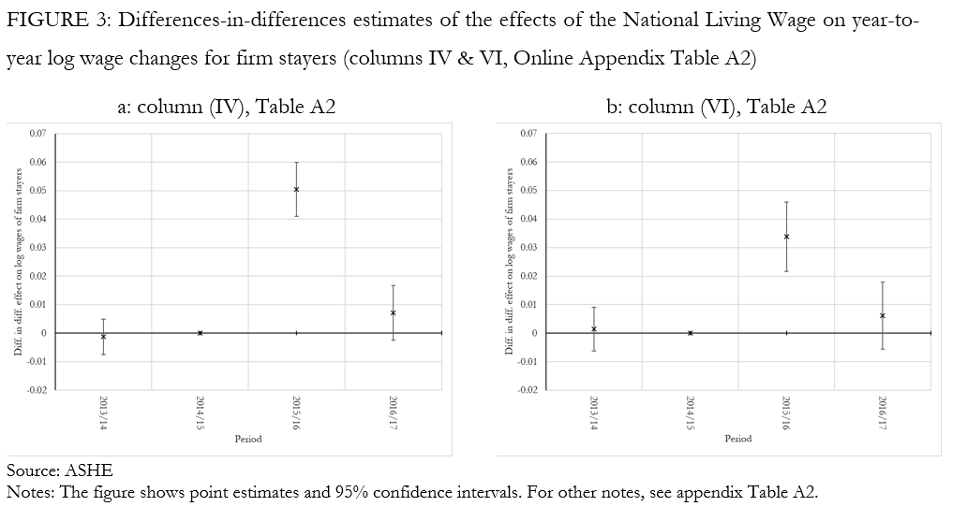
DiD estimates: impact of NLW on wage growth
Introduction | Data | Methods | Results | Discussion
Notes:
DiD of log wage growth
Beta shows difference between treated and control in ref period (2014/15). Small and n.s.
Delta1 shows whether that is different in previous year. This interaction is small and n.s.
Delta2 shows whether it is different in year when NLW introduced. Here, large positive.
Delta3: shows year after that (smaller hike again). Small and n.s.
Col IV is our preferred spec. Same pattern.
Col VI adds firm FE. DiD coeff is a bit smaller. Implies some spillovers within firms.

Slide 11
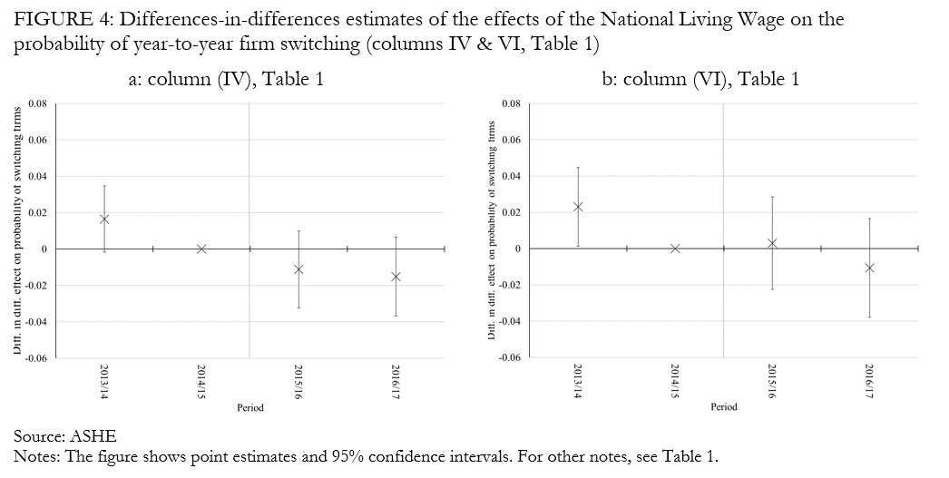
DiD estimates: impact of NLW on mobility
Introduction | Data | Methods | Results | Discussion
Notes:
Focus on column IV
Beta: Mobility is higher among treated than control
Delta1: small and n.s. (parallel trends)
Delta2: negative but n.s.
Delta3: slightly larger (indicative of delayed effect). But still n.s.
Column VI: with Firm FEs
Delta3 very close to zero
Delta4 negative but n.s.
Conclusion: some indication of reduction in mobility, but can’t reject null of no effect

Slide 12
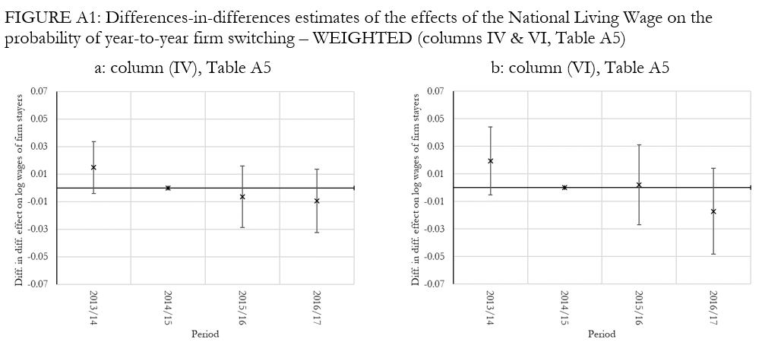
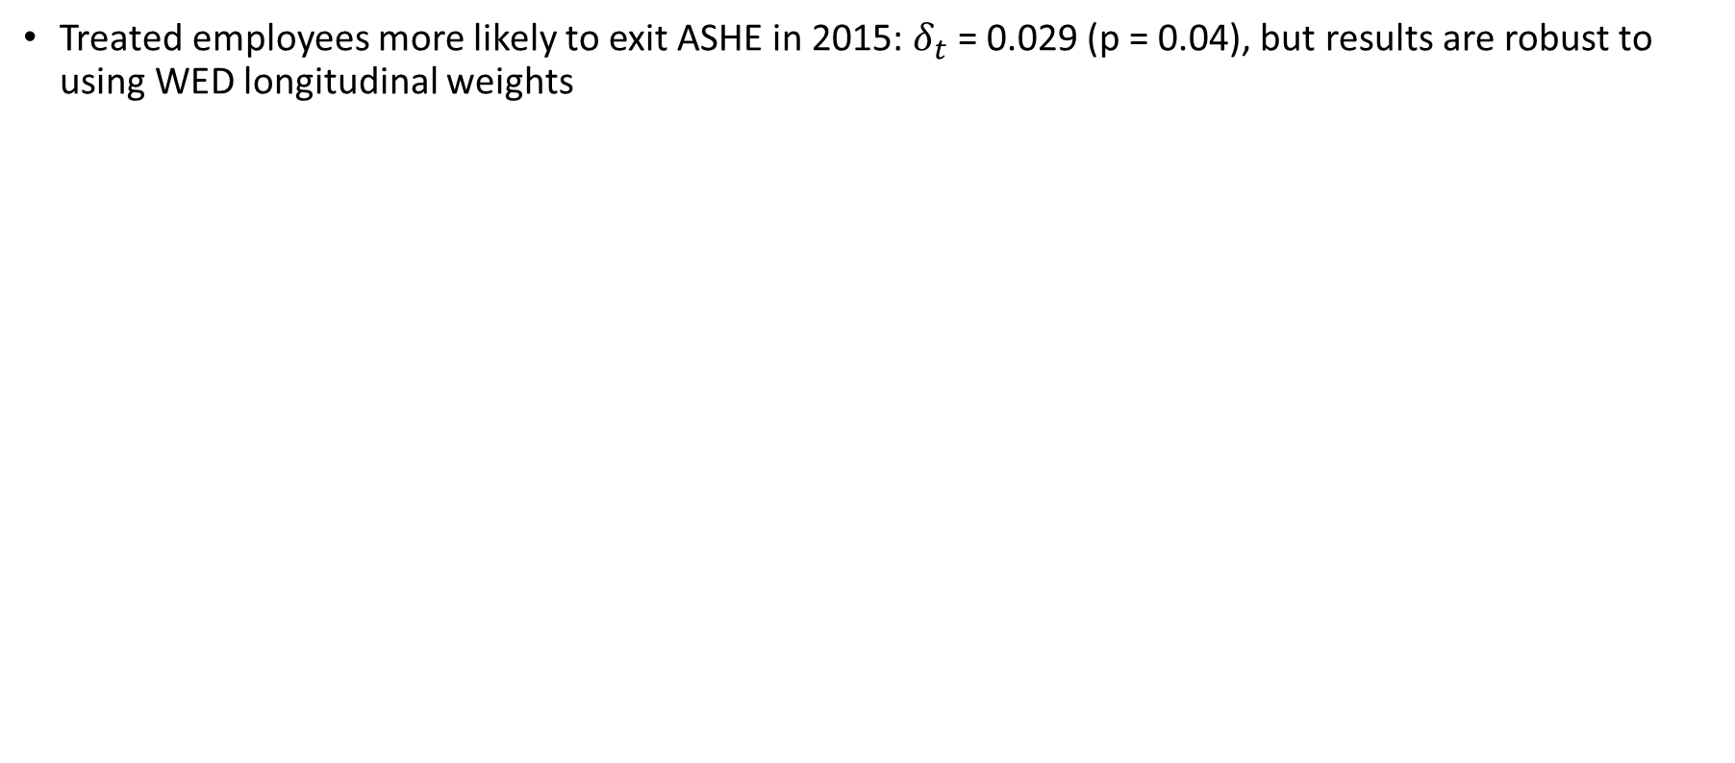
Robustness checks: panel attrition
Treated employees more likely to exit ASHE in 2015: $δ_{t}$ = 0.029 (p = 0.04), but results are robust to using WED longitudinal weights

Slide 13
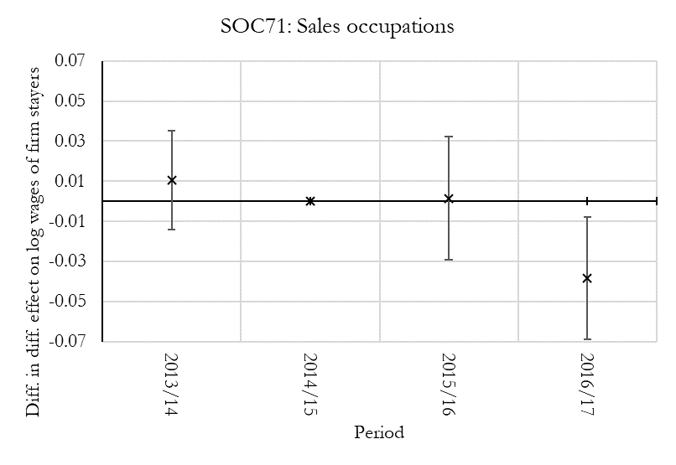
Other robustness & sensitivity checks
Results with firm x period FEs are robust to:
  Extending treatment group to include those with earnings <= incoming NLW + 10p
  Extending treatment group to include those with earnings <= incoming NLW + 50p
  Using all workers earning above the NMW as the control
  Age-based identification strategy: treated workers = aged 25-30; control = aged 22-23 (nb. no wage effect)
Large, low-paying occupations
  SOC61: Caring personal service occupations
  SOC71: Sales occupations
  SOC92: Elementary admin and service occs
Notes:
92 includes cleaning & security

Slide 14
Summary and conclusions
The substantial increase in the wage floor in 2015/16 raised the earnings of low-paid employees in the UK with little evidence of negative employment effects
We study the impact on cross-firm mobility among those who remained in work
Theory gives no clear indication for the direction of any such effects; existing evidence falls on either side
We linked employer-employee data (ASHE) and a DiD estimator to estimate the impact of the rising wage floor on cross-firm mobility
We find no evidence of a treatment effect, on average, providing further evidence of the benign effect of the NLW on employment dynamics

Slide 15
IZA DP 17132
Questions / comments:
john.forth@city.ac.uk

Slide 16
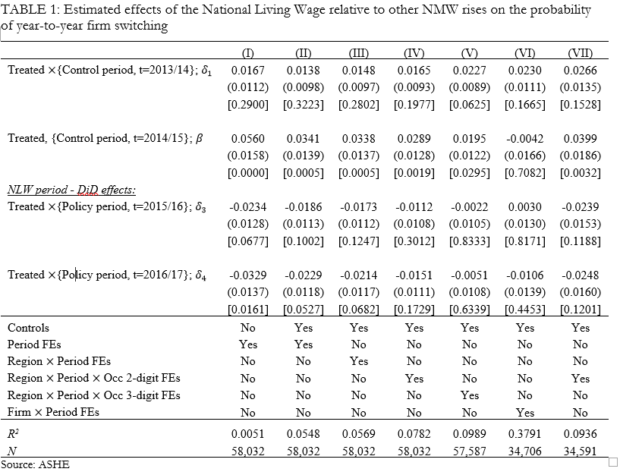
Introduction | Data | Methods | Results | Discussion
Notes:
Focus on column IV
Beta: Mobility is higher among treated than control
Delta1: small and n.s. (parallel trends)
Delta2: negative but n.s.
Delta3: slightly larger (indicative of delayed effect). But still n.s.
Column VI: with Firm FEs
Delta3 very close to zero
Delta4 negative but n.s.
Conclusion: some indication of reduction in mobility, but can’t reject null of no effect

